Slide 2
1 2 3 4 5 6
Parasagittal View of the Human Brain Showing
the Location of Your 6 Coronal Cuts (red lines)

Slide 3
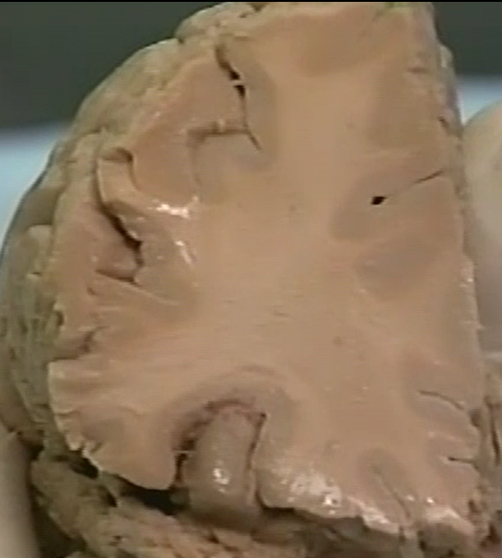
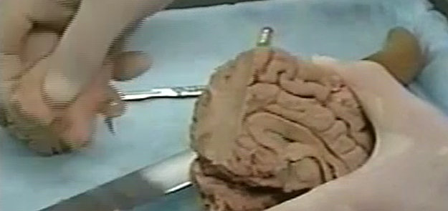
Cut #1
Cut anterior to corpus callosum
white matter
(axons)
gray matter
(cell bodies)

Slide 4
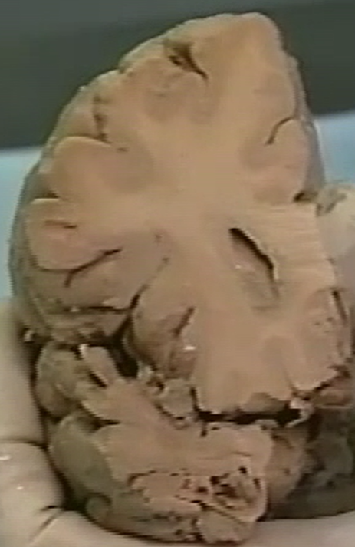
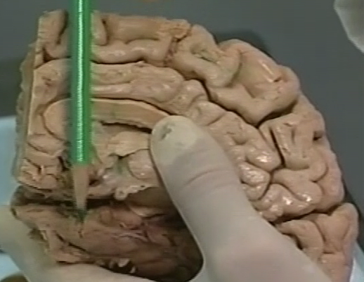
Cut #2
Cut through genu of corpus callosum
cingulate
gyrus
corpus
callosum
lateral
ventricle
temporal lobe
insular lobe

Slide 5
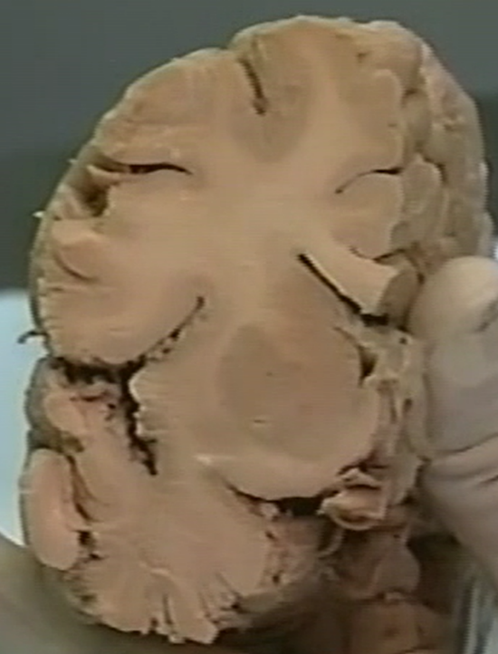
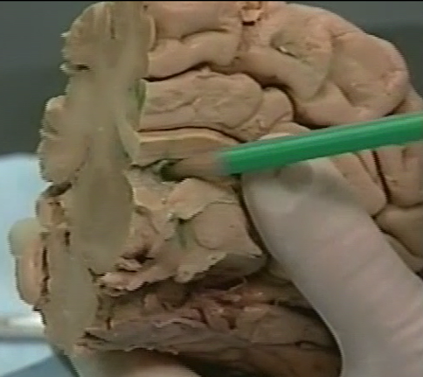
Cut #3
Cut through body of corpus callosum
internal
capsule
(white band)
caudate
cingulate
gyrus
corpus
callosum
lateral ventricle
putamen

Slide 6
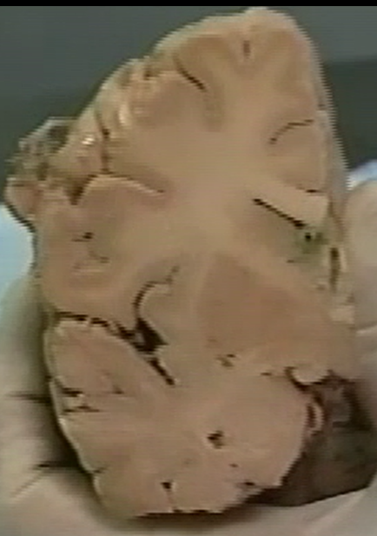
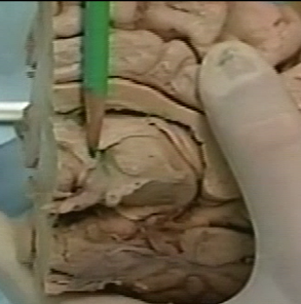
Cut #4
Cut through anterior commissure
internal
capsule
(white band)
caudate
cingulate
gyrus
corpus
callosum
putamen
anterior
commissure
optic
tract
amygdala
Pencil is pointing to
anterior commissure

Slide 7
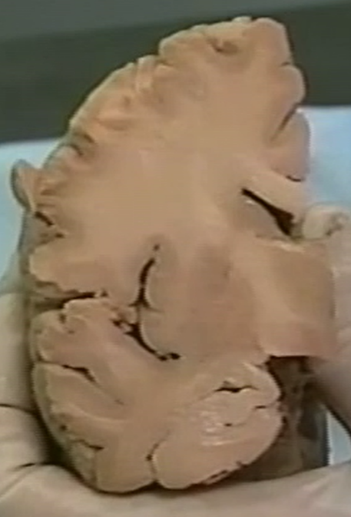
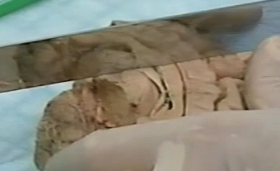
Cut #5
Cut through mammillary body
internal
capsule
(white band)
caudate
cingulate
gyrus
corpus
callosum
putamen
thalamus
globus
pallidus
hypothalamus
mammillary body
hippocampus

Slide 8
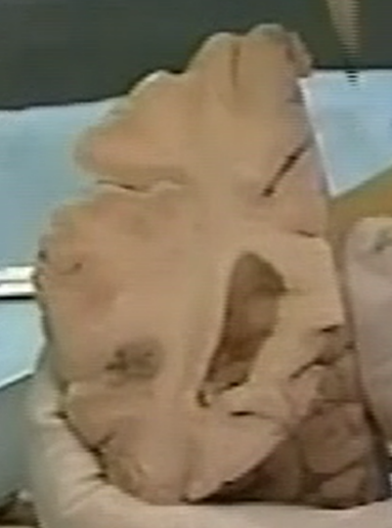
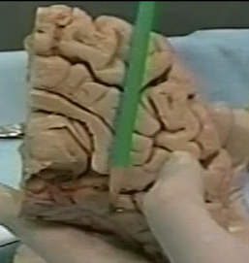
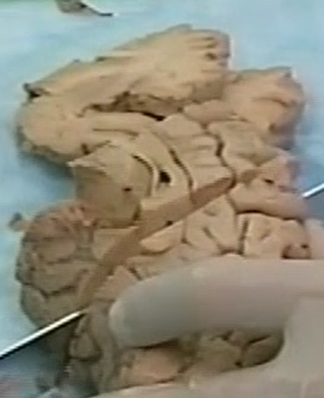
Cut #6
Cut through splenium of corpus callosum
cingulate
gyrus
spenium
of the
corpus
callosum
posterior horn
of the
lateral ventricle
thalamus

Slide 9
1
2
3
Parasagittal View of the Human Brain Showing
the Location of Your 3 Brainstem Cuts (red lines)

Slide 10
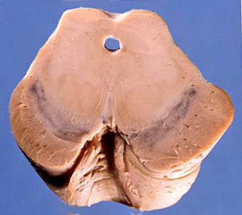
Brainstem Cut #1
Cut through superior colliculus (rostral midbrain)
Superior colliculus
Tectum
1
Cerebral aqueduct
Tegmentum
Substantia nigra
Red nucleus
Crus cerebri
Superior colliculus
Crus cerebri (cerebral peduncle)
Oculomotor nerve (III)

Slide 11
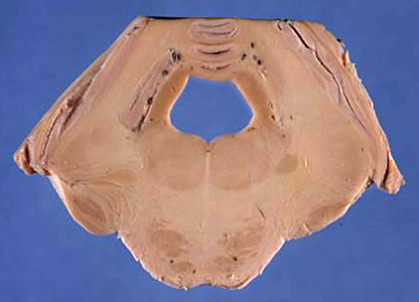
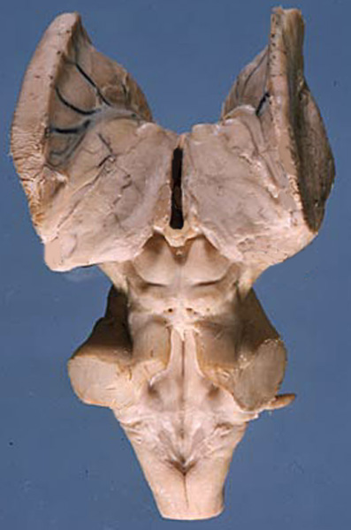
Brainstem Cut #2
Cut through mid-pons
Superior cerebellar peduncle
2
Vermis
Fourth ventricle
Pontine tegmentum
Basilar pons
Middle cerebellar peduncle

Slide 12
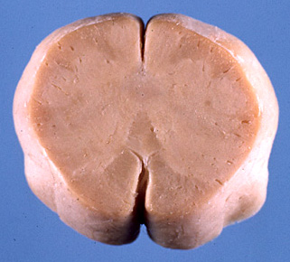
Brainstem Cut #3
Cut through caudal-medulla
Fasciculus graciclis
Fasciculus cuneatus
Nucleus gracilis
3
Nucleus cuneatus
Spinal nucleus V
Pyramidal tract

