Slide 1
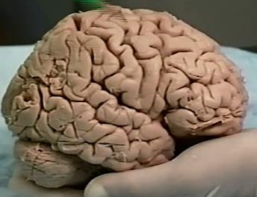
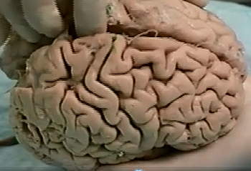
2 Central Sulcus
- separates parietal and frontal lobes
3 Longitudinal Fissure
1 Sylvian or Lateral Fissure
- separates parietal and temporal lobes

Slide 2
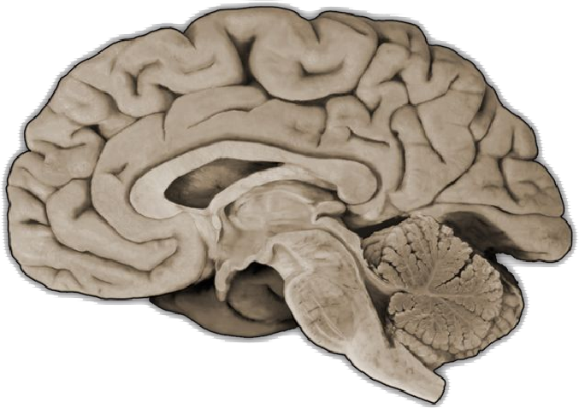
Parieto-Occipital Sulcus
- separates parietal and occipital lobes

Slide 3
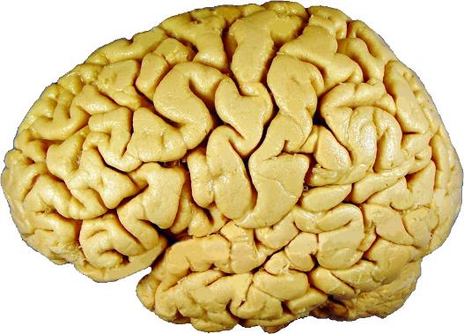
Lettered Sulci
Numbered Gyri
A – Lateral (Sylvian) Fissure
1 –
Precentral Gyrus
B – Central Sulcus
B
2 –
Postcentral Gyrus
C – Inferior Frontal Sulcus
3 –
Inferior Frontal Gyrus
4
4 –
Broca’s Area
1
2
Pars triangularis of Inferior Frontal Gyrus
5 –
Pars Opercularis of Inferior Frontal Gyrus
6 –
9
7 –
Pars Orbitalis of Inferior Frontal Gyrus
8
D
5
6
3
7
C
10
8 –
Middle Frontal Gyrus
11
9 –
Superior Frontal Gyrus
D – Superior Frontal Sulcus
E
10 –
Superior Temporal Gyrus
A
11 –
Middle Temporal Gyrus
E – Superior Temporal Sulcus

Slide 4
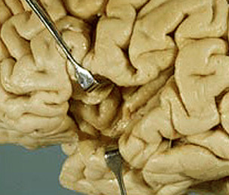
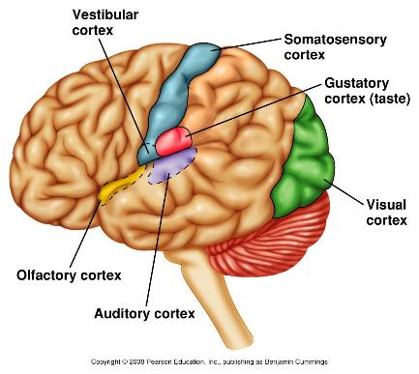
2 – Superior Transverse Temporal Gyri of Heschl
3 – Primary Auditory Cortex
2 – gyri?
3 – functional area?
1 – Lobe?
1 – Insular lobe

Slide 5
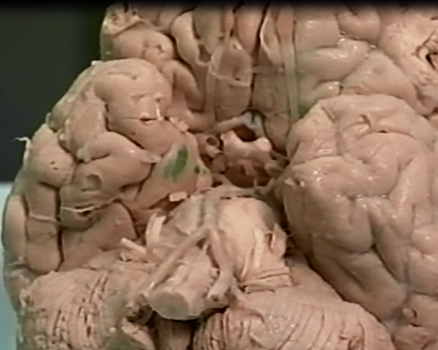
Uncus
Parahippocampal gyri

Slide 6
A – Corpus Callosum
B – Lateral Ventricle
L - Thalamus
C - Fornix
M - Hypothalamus
D – Parieto-Occipital Sulcus
N – Anterior Commissure
E – Cuneus Gyrus
H
O – Superior Colliculus
F – Lingual Gyrus
P – Inferior Colliculus
G – Calcarine Sulcus
I
K
D
H – Central Sulcus
J
A
B – space?
C
E
L
F
M
I – Paracentral Lobule
R
G
J – Cingulate Gyrus
N
K – Superior Frontal Gyrus
O
Q – Cerebral Aqueduct
Q
P
R – 4th Ventricle
Notes:
Vermis means worm in Latin

Slide 7
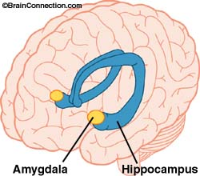
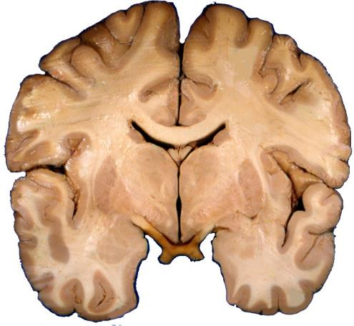
G
F
A - Thalamus
E
B - Hypothalamus
A
C - Amygdala
B
D – Globus Pallidus
D
E – Putamen
C
F – Caudate
G – Fornix
Notes:
Anterior commissure is anterior to this section, would be just ventral to lateral ventricles
Ant. Comm. Cartoon:
http://en.wikipedia.org/wiki/Anterior_commissure#mediaviewer/File:Gray744.png
Ant. Comm. Pic:
http://frontalcortex.com/?page=oll&topic=24&qid=689

Slide 8
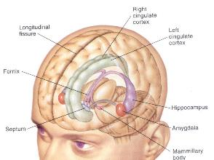
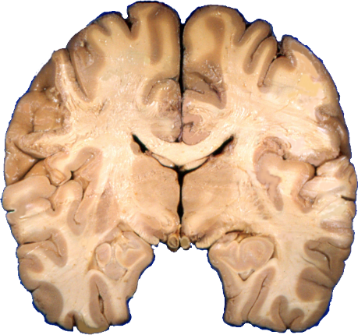
A - Thalamus
B – Subthalamic Nucleus
C - Hippocampus
A
G
D – Globus Pallidus
E
D
B
F
E - Putamen
C
F – Third Ventricle
G - Fornix
H – Parahippocampal Gyrus
H

Slide 9
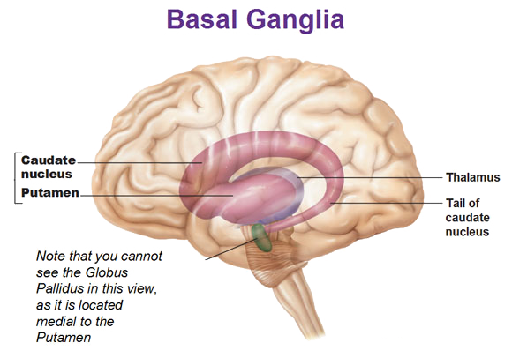
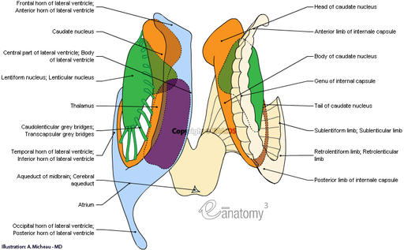
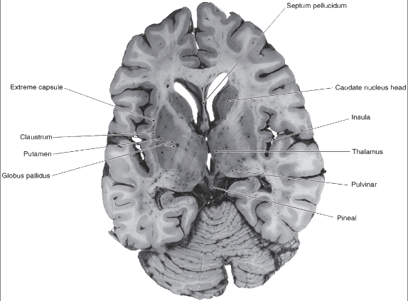

Slide 10
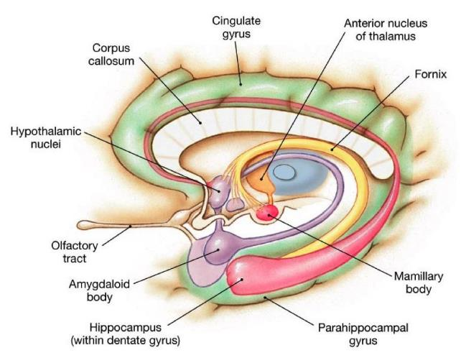

Slide 11
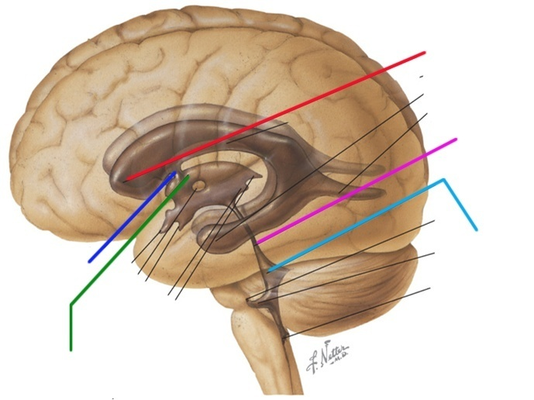
Ventricular System
1.
Lateral Ventricle
4.
Cerebral Aqueduct of Sylvius
5.
Fourth Ventricle
2.
Interventricular Foramen of Monro
3.
Third Ventricle

Slide 12
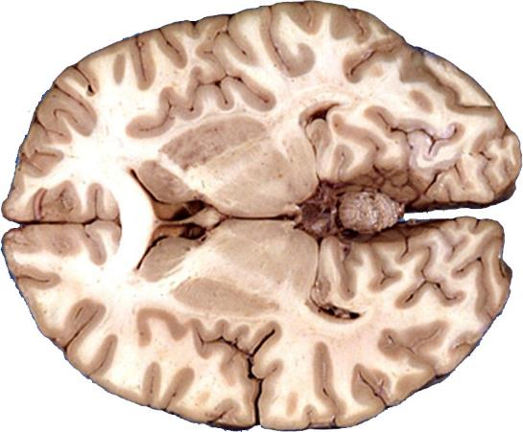
H
G
A – Corpus Callosum
F
B
B – Internal Capsule, Anterior Limb
K
C – Caudate Nucleus
D – Septum Pellucidum
E - Thalamus
F - Putamen
A
E
G – Globus Pallidus
H – Third Ventricle
I – Posterior Horn Lateral Ventricle
J – Internal Capsule, Posterior Limb
K–Primary Visual Cortex
C
D
I
J

