Slide 1
Thalamus
Basic functions of different thalamic nuclei
Cellular level: basic functions of typical thalamic neurons
Thalamic neurons role in sleep and Absence epilepsy
Kimberle M. Jacobs, PhD
827-2135
kmjacobs@vcu.edu

Slide 2
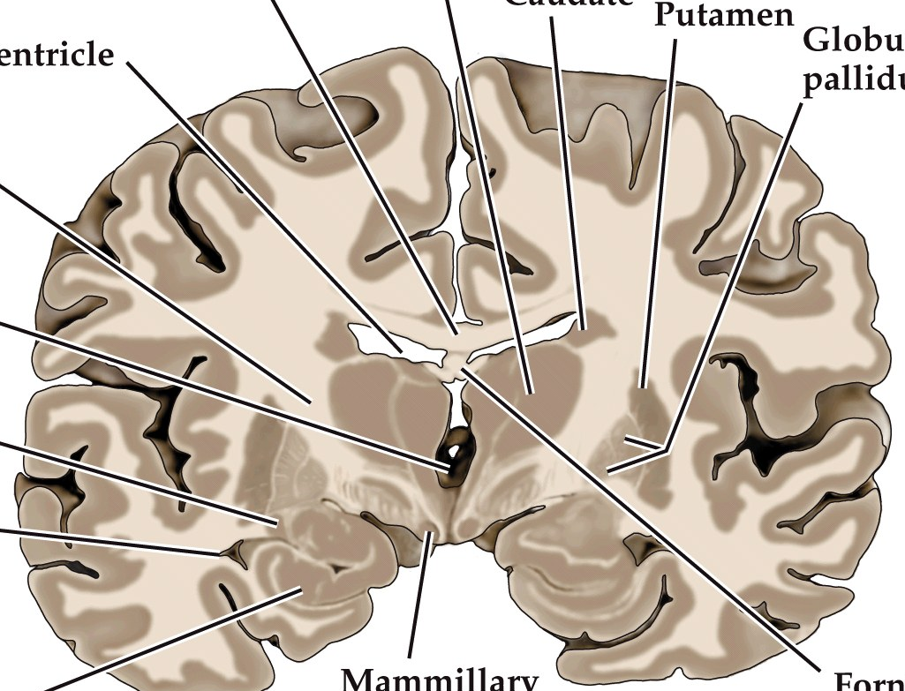
Thalamic location in sections
The thalamus is medial to the putamen and ventral to the somatosensory cortex

Slide 3
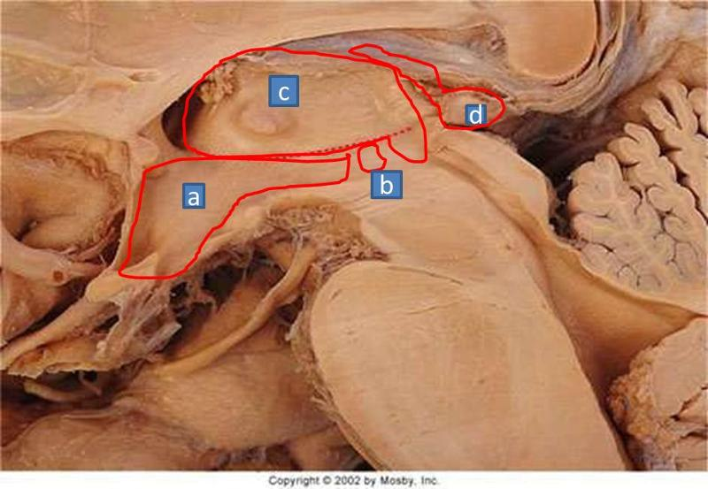
Thalamic aspects of the Diencephalon
Thalamus
(Dorsal Thalamus)
Epi
Sub
Epi Thalamus – pineal gland attached + habenular nucleus – limbic system, circadian rhythms
THALAMUS = Dorsal Thalamus
Sub Thalamus – motor functions – (connected to basal ganglia and substantia nigra - target for Parkinson’s surgery)

Slide 4
This is a video of conjoined twins. The first twin, Krista has her eyes covered. A toy is shown to the second twin, Tatiana. Then their mother asks Krista with her eyes covered what is the toy? Krista knows what the toy is despite the fact that she didn’t see it with HER eyes.
How does she know?
http://video.nytimes.com/video/2011/05/13/magazine/100000000814707/two-united-as-one.html
Start – then 1:56

Slide 5
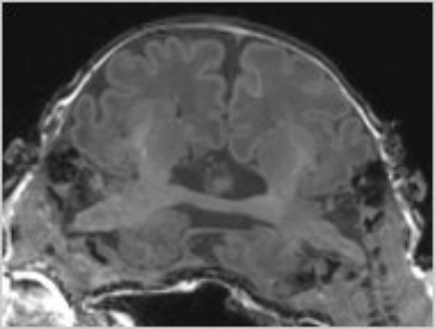
Conjoined twins connected at thalamus
http://video.nytimes.com/video/2011/05/13/magazine/100000000814707/two-united-as-one.html
One twin can transfer information from her fingers or eyes to the consciousness of the other twin because they share the thalamus. They both have inputs to that thalamus and it projects to both of their cortices.
An important function of the thalamus is transferring sensory information from the periphery to consciousness (cortex)

Slide 6
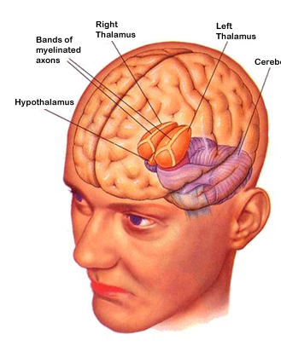
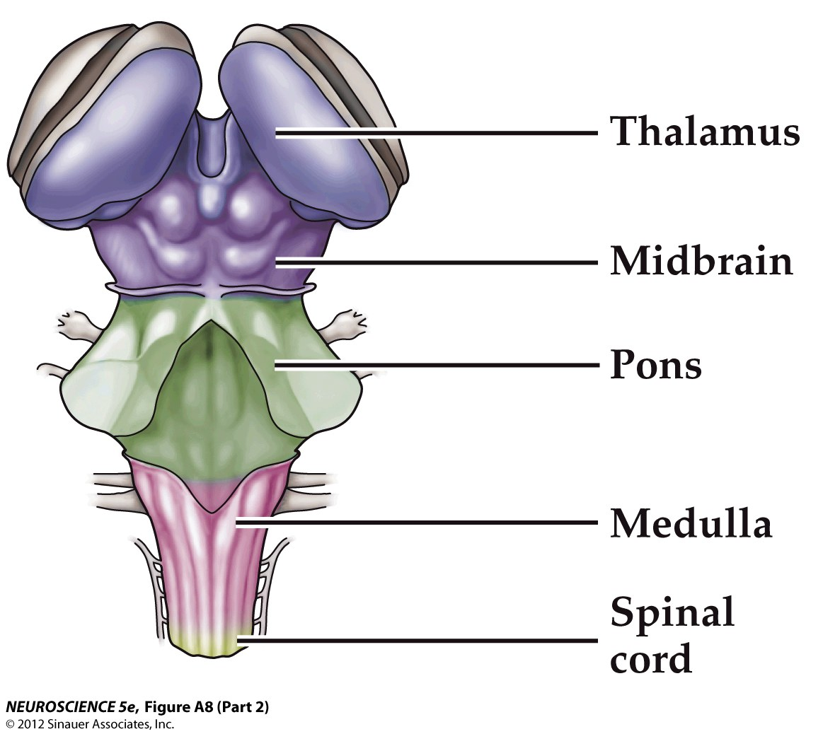
Thalamus – Sensory Gateway to the Cortex
Dorsal Surface
Notes:
Each hemisphere has an egg-shaped thalamus that consists of a number of different nuclear groups

Slide 7
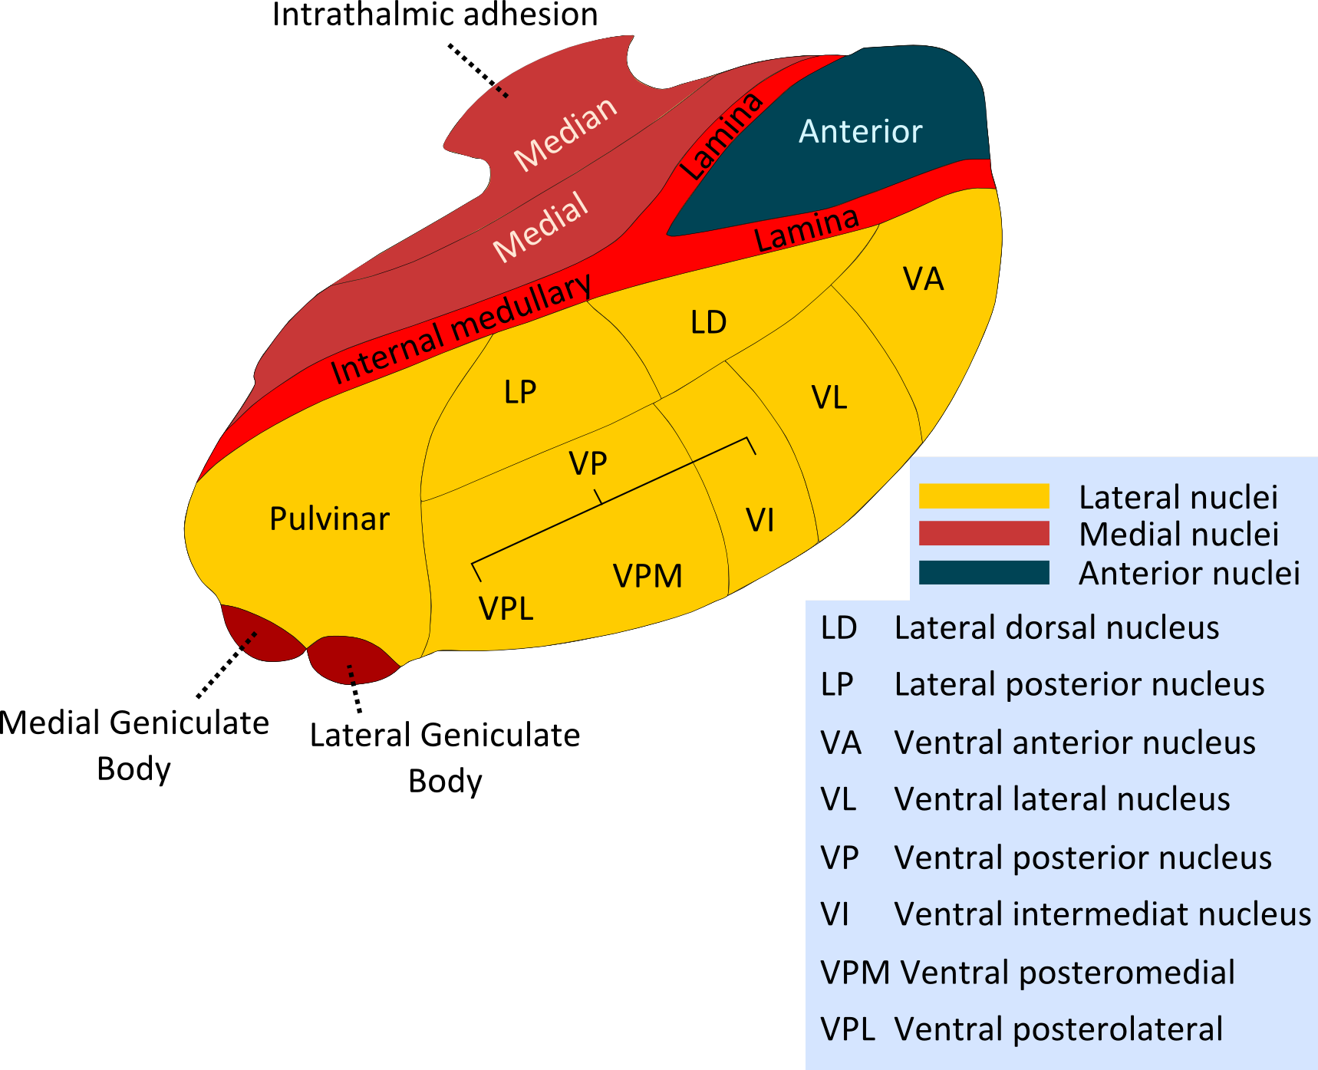
Thalamic Structure: 3 Main Groups of Nuclei
Anterior: attention, memory and learning
anterior nuclei
Medial: sensory integration for abstract thinking and long-term, goal oriented behavior
dorsomedial (DM) nucleus also called Mediodorsal(MD)
Lateral: motor and sensory relay
dorsal tier: lateral dorsal (LD); lateral posterior (LP), pulvinar (P) nuclei
ventral tier: ventral anterior (VA) and ventral lateral (VL) nuclei involved in motor control with cerebellum and basal ganglia (VL)
ventral posterior nucleus (VP) is divided into VPL (somatosensory relay for body) and VPM (somatosensory for head)
Posterior to ventral tier is LGN (visual relay) and MGN (auditory relay)
The internal medullary lamina divides the thalamus into anterior, medial and lateral nuclear groups. The lateral nuclear groups are subdivided into dorsal and ventral tiers
Notes:
Internal medullary lamina connect different thalamic nuclei
Intralaminar nuclei (within internal medullary lamina) – receive input from reticular information as well as spinothalamic and trigeminothalamic fibers – these nuclei play a role in consciousness or alertness

Slide 8
Visual Thalamus: Lateral Geniculate Nucleus (LGN)
Anterior
Medial
Mediodorsal
Anterior
LD
LP
VA
VL
Posterior
VPL
Pulvinar
MGN
LGN
VPM
Lateral
VA = Ventral Anterior
VL = Ventral Lateral
LD = Lateral Dorsal
LP = Lateral Posterior
VPL = Ventral Posterior Lateral
VPM = Ventral Posterior Medial
LGN = Lateral Geniculate Nucleus
MGN = Medial Geniculate Nucleus

Slide 9

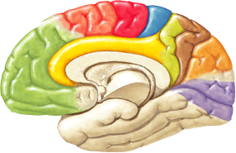
Thalamus: Lateral Geniculate Nucleus (LGN)
Thalamic LESION:
in LGN: contralateral homonymous hemianopsia - same hemifield in both eyes lost
Function
LGN: Vision
Lesion on right side produces loss on left side
Medial
Posterior
Optic Tract
Lateral
LGN
input
output
Primary Visual Cortex
Area 17
LGN = Lateral Geniculate Nucleus

Slide 10
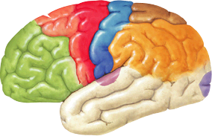
Thalamus: Medial Geniculate Nucleus (MGN)
Thalamic LESION:
in MGN unilateral lesions have little effect on hearing, because auditory information from each ear ascends bilaterally. But bilateral lesions will cause auditory deficits.
Function
MGN: Audition
Anterior
Medial
Inferior Colliculus
input
MGN
Lateral
output
Primary Auditory Cortex
Areas 41 & 42
MGN = Medial Geniculate Nucleus

Slide 11
Thalamus: Ventral Posterior Medial and Lateral (VPM, VPL)
Thalamic LESION:
In VPL - Loss of touch, pain, temperature and conscious proprioception, in the contralateral body; for VPM: same modalities, contralateral (to lesion) head and face.
Function
VPM, VPL: Somatosensation of head and body, respectively
Includes touch, pain, temperature, proprioception
Anterior
Medial
VPL = Ventral Posterior Lateral
VPM = Ventral Posterior Medial
Posterior
VPL
VPM
output
input
Ventral trigeminothalamic tract
Medical Lemniscus,
Lateral spinothalamic tract
Primary Somatosensory Cortex
Areas 3, 1 & 2

Slide 12
Thalamic Pain or Central Pain Syndrome
Interrupting pain tracts can cause pain sensation
Paradoxically, some patients experience abnormally painful sensations (Athalamic pain) on the anesthetic side.
After a stroke, a person may experience thalamic pain or “central pain syndrome” due to damage to the spinal tracts that carry pain and temperature sensation from the periphery to the thalamus.
Damage to the spinothalamic or trigeminothalamic tract result in severe, spontaneous pain in the parts of the body connected to the damaged tracts.
Thalamic pain starts several weeks after the stroke and presents as an intense burning pain on the side of the body affected by the stroke and is often worsened by cutaneous stimulation.
If interested – treatment involving temperature changes in good limb combined with mirror therapy: https://www.youtube.com/watch?v=eRKCla2JIL4

Slide 13
Repetitive TMS helps alleviate Central Pain Syndrome
Longlasting antalgic effects of daily sessions of repetitive transcranial magnetic stimulation in central and peripheral neuropathic pain
Khedr et al 2005 J Neurol Neurosurg Psychiatry, 76: 833.
Real vs sham TMS
10 min rTMS over hand area of motor cortex at 80% of motor threshold every day for 5 days
TGN = trigeminal neuralgia
PSP = post stroke pain
VAS = visual analogue scale
LANSS = Leeds assessment of neuropathic symptoms and signs
Post 1 is after first session of TMS
Post 2 is after 4th session
Post 3 is after 5th session
Last point is 2 weeks later.
2017 Meta-analysis: “Use of rTMS improves the efficacy of conventional medical treatment in chronic pain patients. This treatment is not associated with any direct adverse effects. However, the duration and frequency of rTMS therapy is presently highly variable and needs standardization.” Anesth Essays Res, 11: 751.
Notes:
Typically patients had had pain for months and other treatments had been tried and were ineffective. Simple stimulation could set off the pain.

Slide 14
Thalamus: Ventral Anterior (VA)
Thalamic LESION:
In VA interruption of basal ganglia input may result in akinesia (loss of voluntary movement).
Function
VA: Initiation and planning of movement
VA = Ventral Anterior
Anterior
Medial
Basal Ganglia
VA
input
Posterior
output
Premotor Cortex
Area 6

Slide 15
Thalamus: Ventral Lateral (VL)
Thalamic LESION:
In VL interruption of basal ganglia input may result in akinesia (loss of voluntary movement).
Function
VL: Modulation and Coordination of movement
VL = Ventral Lateral
Anterior
Medial
VL
Basal Ganglia and
Cerebellum
Posterior
input
output
Primary Motor Cortex
Area 4

Slide 16
Thalamus: Pulvinar
Thalamic LESION:
Lesion of the pulvinar can produce neglect or attentional deficit syndromes.
Function
Pulvinar: Higher order visual function
Anterior
Medial
Superior and
Inferior Colliculi
input
Pulvinar
MGN
LGN
output
LGN = Lateral Geniculate Nucleus
Visual Association
Cortex
MGN = Medial Geniculate Nucleus

Slide 17
Thalamus: Mediodorsal Nucleus (MD)
Prefrontal Cortex
output
Anterior
Temporal Lobe, Amygdala & Hypothalamus
Mediodorsal
input
Posterior
Lateral
Thalamic LESION:
Function
Mediodorsal: motivation, drive, emotion – sensory integration for abstract thinking and goal-directed behavior, may play a role in personality
In MD can cause memory deficits, particularly when involving temporal lobe inputs

Slide 18
Thalamus: Anterior Nucleus
Function
Mammillothalamic Tract
Anterior: Memory storage and emotion
input
Anterior
output
Cingulate Cortex
Posterior
Lateral
Thalamic LESION:
In Anterior Nucleus can cause memory deficits – significant amnesia
Notes:
LD and LP likely integrating visual, somatosensory input and emotional and memory information

Slide 19
Additional Effect of Thalamic Lesions
Cognitive function:
Arousal: bilateral lesions affecting the intralaminar thalamic nuclei, which can be considered extensions of the brainstem reticular formation, can cause unresponsiveness, but the eyes remain open. This has been called coma vigil or akinetic mutism.
Memory: Lesions affecting medial thalamic structures (the confluence of mammillothalamic and amygdalofugal tracts, dorsomedial and possibly anterior nuclei) can cause profound amnesia.
Other cognitive functions: aphasia, neglect and visuospatial dysfunction have been described with thalamic lesions, and presumably relate to interruption of reciprocal thalamic connections with the cerebral cortex.

Slide 20
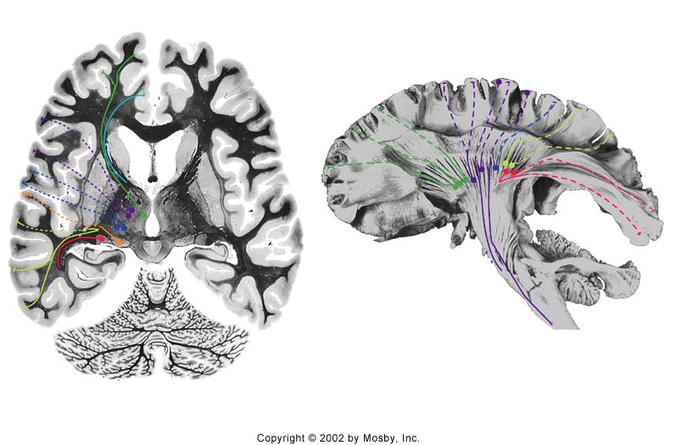

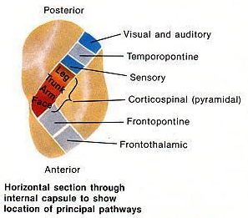
Thalamus: Internal Capsule
VA/VL to motor Ctx areas
VPL/VPM to somat Ctx
DM to
Prefrontal Ctx
Pulvinar/LP
to association Ctx
LGN to Visual Ctx

Slide 21
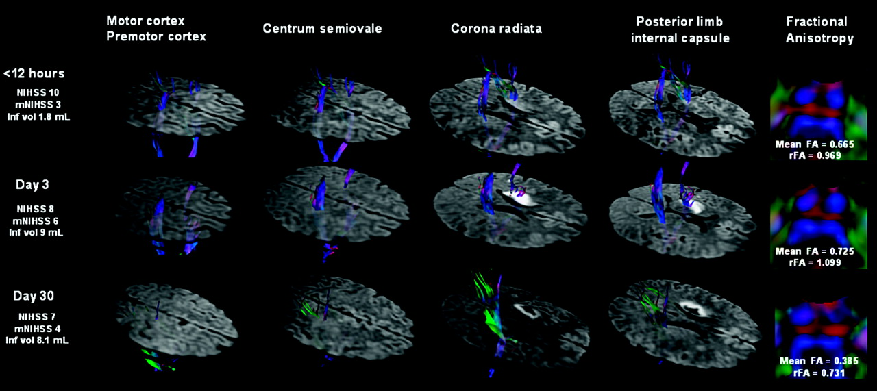
Acute Damage to the Posterior Limb of the Internal Capsule on Diffusion Tensor Tractography as an Early Imaging Predictor of Motor Outcome after Stroke
J. Puig, S. Pedraza, G. Blasco, J. Daunis-i-Estadella, F. Prados, S. Remollo, A. Prats-Galino, G. Soria, I. Boada, M. Castellanos and J. Serena
American Journal of Neuroradiology May 2011, 32 (5) 857-863; DOI: https://doi.org/10.3174/ajnr.A2400
“CONCLUSIONS: In the acute setting, DTT [Diffusion Tensor Tractography] is promising for stroke mapping to predict motor outcome. Acute CST [Cortical Spinal Tract] damage at the level of the PLIC [Posterior Limb of the Internal Capsule] is a significant predictor of unfavorable motor outcome.”
“Damage to the PLIC in the first 12 hours and at day 3 after stroke correlated with clinical severity, axonal damage expressed as decreased FA and rFA values, and motor outcome at day 30 and day 90 (P < .001) better than damage to any other CST region.” No sig correlation btw acute infract volume and motor outcome!
Notes:
A 47-year-old man (patient 15) presented a mild right-sided hemiparesis lasting 45 minutes. DTT of motor tracts superimposed on DWI are shown tridimensionally. A small infarct in the striatocapsular MCA territory involves the left CST. Note the slight hyperintensity of the CST involved by the infarct due to the short time elapsed since the onset of symptoms. The markedly reduced brightness on the left side and decreased FA value in the left descending CST at day 30 are regarded as WD. [Wallerian Degeneration] – nerve fiber crushed or cut – axon distal to injury degenerates.
Our previous study demonstrated that mean FA values along the affected CST were significantly lower than the normal contralateral side only at day 30 after stroke onset (P < .001), and these values were lower than the corresponding FA values obtained at admission and at day 3. Moreover, the decrease in mean FA values correlated positively with the motor deficit at 30 days after stroke.¹⁹
FAA measured with DTT – is a measure of the integrity of a tract – reduced values indicate less integrity in the tract

Slide 22
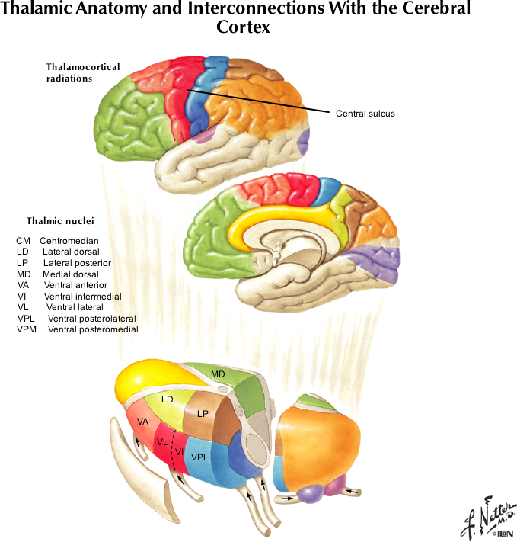
Associations between specific thalamic and specific cortical regions

Slide 23
B) Cellular level: basic functions of typical thalamic neurons
Basic functions of different thalamic nuclei
Cellular level: basic functions of typical thalamic neurons
Thalamic neurons role in sleep and Absence epilepsy

Slide 24
Specific Relay Nuclei have Specific Relay Neurons that provide the focal high resolution input to Primary Cortical Areas
Primary Cortex
Examples:
Specific Relay Nucleus → Primary Cortical Region
VL → Primary Motor Cortex
VPM/VPL → Primary Somatosensory Cortex
MGN → Primary Auditory Cortex
LGN → Primary Visual Cortex
Not for testing:
taste area is medial VPM → Primary Gustatory Cortex
Olfaction goes directly to cortex – so no specific olfactory thalamic nucleus but thalamic lesions can modify whether things smell good and what you think the smell is – suggesting that olfactory cortex provides some inputs to thalamus.
Specific Relay Neuron
Specific Relay Nucleus
of the
THALAMUS

Slide 25
Thalamic input to cortex
Primary Cortex
Although the main large input from thalamus is to layer IV, there is also a small input to superficial layer VI from the same cells
Specific Relay Neuron
Specific Relay Nucleus
of the
THALAMUS

Slide 26
Thalamic input to cortex
Primary Cortex
Within specific thalamic nuclei, there are 2 types of thalamic cells. Specific relay cells and nonspecific cells. The nonspecific cells project diffusely to superficial layers of the cortex.
That is all you need to know about the nonspecific cells. They likely provide attentional cues – for the specific input conveyed by the specific relay neurons. We can stain for instance for calcium binding proteins and differentiate these two cell types. If interested, see: Thalamic circuitry and thalamocortical synchrony. Jones EG. Philos Trans R Soc Lond B Biol Sci. 2002 Dec 29;357(1428):1659-73.
Non-specific Relay Neuron
Specific Relay Neuron
Specific Relay Nucleus
of the
THALAMUS

Slide 27
Cortex Provides Feedback to the Thalamus
Primary Cortex
Layer IV = input to cortex
Layer VI = output back to the specific relay nucleus that innervates layer IV directly above the layer VI cells
Cortico-thalamic fibers (from cortex to thalamus)
Specific Relay Neuron
Specific Relay Nucleus
of the
THALAMUS

Slide 28
How does the information get down to cortical layer VI?
Primary Cortex
Intracortical connections transfer the information (after processing) down to layer VI
Layer IV = input to cortex
Layer VI = output back to the specific relay nucleus that innervates layer IV directly above the layer VI cells
The projection from layer V pyramidal neurons to layer VI are axonal collaterals,
as you will see – these cells also have other projections
Specific Relay Neuron
Specific Relay Nucleus
of the
THALAMUS

Slide 29
Primary Cortex Provides a Connection to Higher Order Thalamus
Primary Cortex
In general what does higher order mean?
It means there is additional processing that has gone on in some CNS center. Secondary Cortex is higher order because primary cortex already received that information did some computation through intracortical connectivity and then passed it to secondary cortex.
Higher order thalamus – processing has already occurred in both the primary thalamic nucleus and within the cortex so when it gets to higher order thalamic nucleus – it is ‘higher’ level (more processed) information.
OUTPUT to higher order thalamic centers
Specific Relay Neuron
Specific Relay Nucleus
of the
THALAMUS
Higher Order Nucleus
of the
THALAMUS

Slide 30
Primary Cortex Provides a Connection to Higher Order Thalamus
Primary Cortex
Specific Relay Neurons in the primary or specific relay nuclei can also be called DRIVERS – they are driving the information.
The thalamic cell in the higher order thalamic nucleus is called a modulator cell – because it is only affecting the information after it is already received – so at higher levels modulation occurs.
The function of the modulator neurons is to amplify the gain of the signal, that is they can make a specific stimulus become more important.
Modulator
cell
DRIVER
cell
Specific Relay Nucleus
of the
THALAMUS
Higher Order Nucleus
of the
THALAMUS

Slide 31


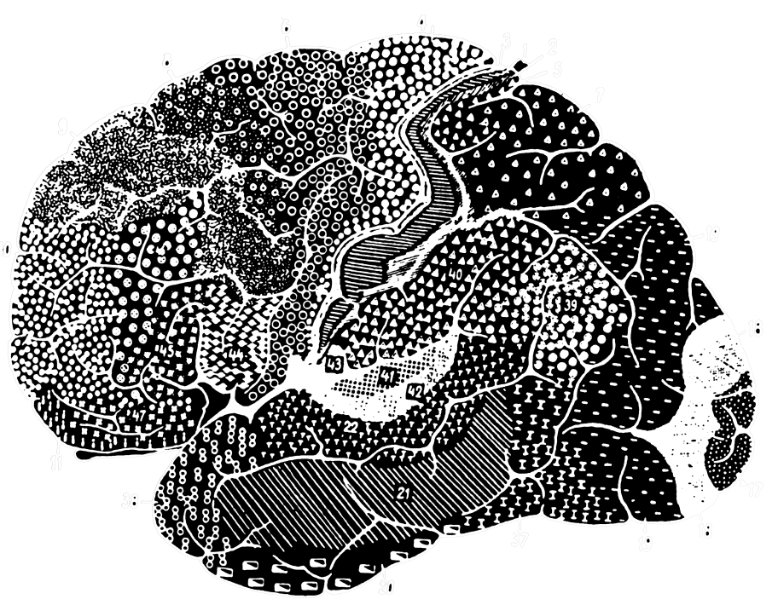
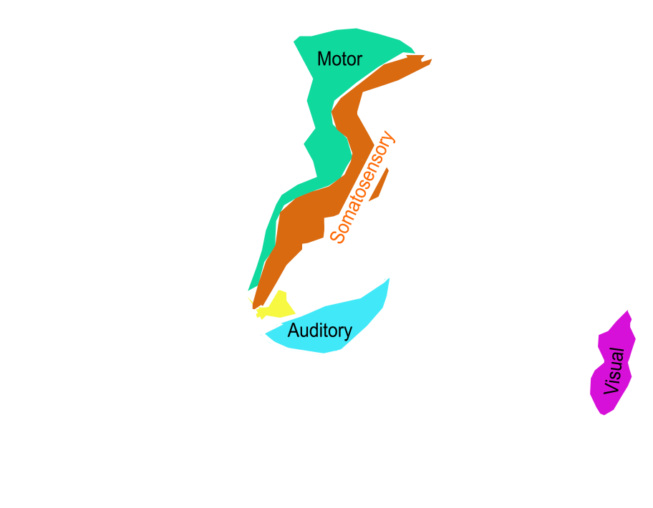
Secondary cortical areas surround primary areas. Much of what is left is Association cortex where senses are integrated
Primary Areas Identified
Secondary Areas Added
Core Field (primary)
Belt - Less Specialized (secondary)
Association areas

Slide 32
Thalamic cells project mainly to layer IV and receive back from layer VI
Primary Cortex
Secondary Cortex
Higher order thalamic nucleus projects to layer IV of SECONDARY Cortex
Modulator
cell
DRIVER
cell
Specific Relay Nucleus
of the
THALAMUS
Higher Order Nucleus
of the
THALAMUS

Slide 33
There are three (known) levels of this hierarchy – the pattern is the same
Primary Cortex
Secondary Cortex
An important function of the higher order thalamic nuclei is to take information from one cortical area and convey it to another cortical area.
Modulator
cell
DRIVER
cell
Modulator
cell
Specific Relay Nucleus
of the
THALAMUS
Higher Order Nucleus
of the
THALAMUS
Highest Order Nucleus
of the
THALAMUS

Slide 34
There are three (known) levels of this hierarchy– the pattern is the same
Primary Cortex
Secondary Cortex
Association Cortex
Modulator
cell
DRIVER
cell
Modulator
cell
Specific Relay Nucleus
of the
THALAMUS
Higher Order Nucleus
of the
THALAMUS
Highest Order Nucleus
of the
THALAMUS

Slide 35
EXAMPLE FOR VISION
Primary Visual Cortex (Area 17)
Secondary Visual Cortex (Area 18)
Visual Association Cortex
Lateral Geniculate Nucleus
Pulvinar (part a)
Pulvinar (part b)
Modulator
cell
DRIVER
cell
Modulator
cell
LGN = Specific Relay Nuc
of the
THALAMUS
Higher Order Nucleus
of the
THALAMUS
Highest Order Nucleus
of the
THALAMUS

Slide 36
C) Thalamic neurons role in sleep and Absence epilepsy
Basic functions of different thalamic nuclei
Cellular level: basic functions of typical thalamic neurons
Thalamic neurons role in sleep and Absence epilepsy

Slide 37
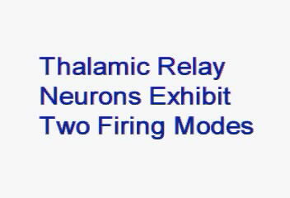
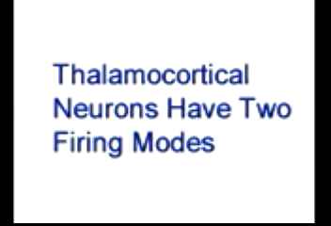
Thalamic Neurons have 2 firing modes: Bursting and Single Spike Firing
Where do these oscillations come from? The bursting ability of thalamic neurons
rly_osc.mpeg
rly_exp.mpeg

Slide 38
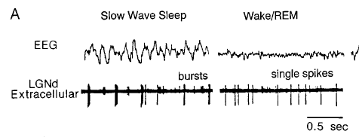
Thalamic Neurons have two firing Modes: Single Spike and Burst-firing
EEG
LGN Single Unit
McCormick & Bal 1997 Annu Rev Neurosci, 20: 185.
During burst-firing – thalamic neurons can no longer faithfully transmit information from the periphery to the consciousness (cortex) because they cannot do frequency following.
Relay neurons transmit burst-firing to cortex – large numbers of thalamic and cortical neurons firing synchronously means large amplitude EEG waves.
Connections between nRt and Relay Neurons control whether spindling occurs (and the amount of synchronization within the Relay Nuclei)

Slide 39
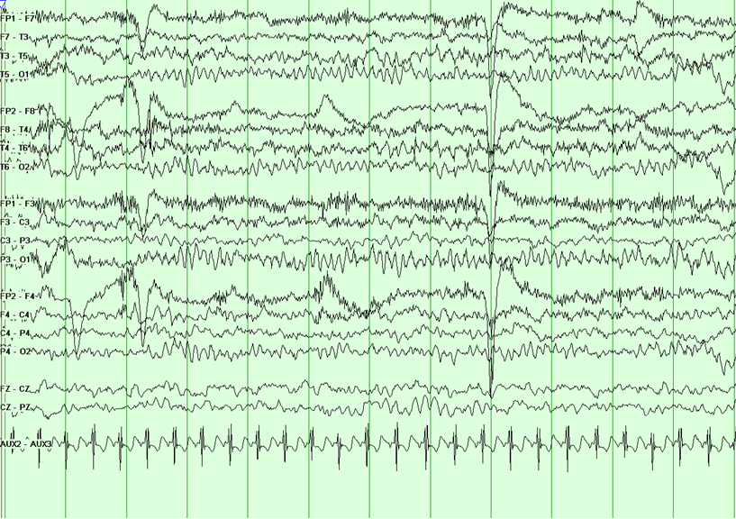
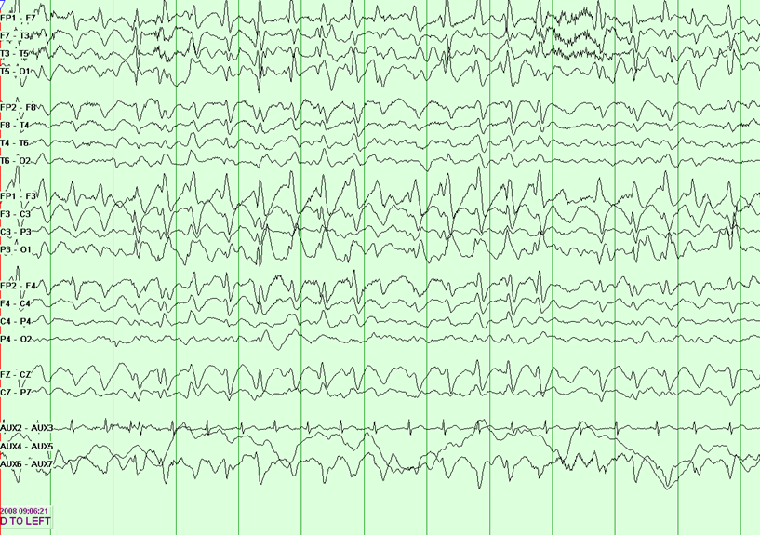
How is the thalamus involved in Epilepsy?
Nucleus reticularis (nRT) contains inhibitory interneurons and is an initiator of sleep spindles – initiating the bursting pattern of thalamic neurons.
In Angelman’s syndrome, there is a mutation of GABA receptors specifically within nRT.
These receptors occurring at nRT -> nRT synapses, normally act to desynchronize the nucleus. Without these receptors – once the bursting starts in one part of the nucleus, it spreads to the whole nucleus and intiates a seizure.
Patients with this syndrome have Absence seizures. This is treated with the drug Ethosuximide, which blocks a T-type Calcium channel in the thalamic neurons, and thereby reduces their ability to burst.
Normal EEG
Angelman’s 3 Hz Spike and Wave
Graph lines are 1 sec divisions
https://www.angelman.org/what-is-as/medical-information/epilepsy-and-its-treatment-for-providers/

Slide 40
Questions
The VA nucleus of the thalamus receives input from ______ and sends output to ______ .
Basal Ganglia, Premotor Cortex
Trigeminothalamic tract, Primary Somatosensory Cortex
Motor Cortex, Cerebellum
Spinothalamic and Medial Lemniscus tracts, Facial Nucleus
Mammillothalamic tract, Cingulate Cortex
Answer = A
The Anterior nucleus of the thalamus receives input from ______ and sends output to ______ .
Basal Ganglia, Premotor Cortex
Trigeminothalamic tract, Primary Somatosensory Cortex
Motor Cortex, Cerebellum
Spinothalamic and Medial Lemniscus tracts, Facial Nucleus
Mammillothalamic tract, Cingulate Cortex
Answer = E

Slide 41
Questions
The MGN and VL thalamic nuclei have roles in _______ and ______.
Vision, Preparation of Movement
Audition, Coordination of Movement
Somatosensation, Memory
Motivation, Emotion
Higher order visual function, Initiation of Movement
Answer = B
Specific Relay Nuclei of the thalamus send projections to what layer of the cortex and receive projections back to the same nucleus from what layer of the cortex?
Layer V, Layer III
Layer II, Layer IV
Layer VI, Layer IV
Layer IV, Layer VI
Layer III, Layer V
Answer = D

Slide 42
Questions
A major role of specific thalamic relay neurons is:
Provide nonspecific general attentional information for a specific sense
Drive high resolution focused sensory information to perception (the cortex)
Connect thalamic reticular and specific thalamic relay nuclei
Amplify the gain of the signal
Provide connections between senses within the thalamus
Answer = B
A major role of modulatory neurons within higher order thalamic nuclei is to:
Provide nonspecific general attentional information for a specific sense
Drive high resolution focused sensory information to perception (the cortex)
Connect thalamic reticular and specific thalamic relay nuclei
Amplify the gain of the signal
Provide connections between senses within the thalamus
Answer = D

