Slide 1
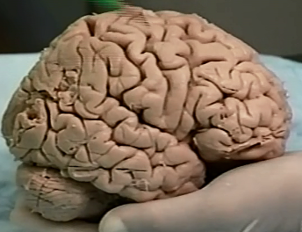
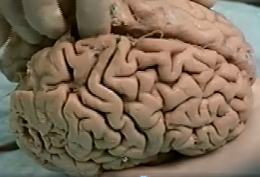
2 Central Sulcus
- separates parietal and frontal lobes
3 Longitudinal Fissure
1 Sylvian or Lateral Fissure
- separates parietal and temporal lobes

Slide 2
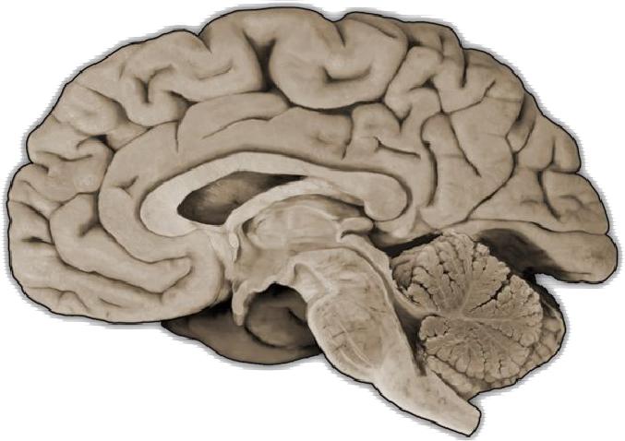
Parieto-Occipital Sulcus
- separates parietal and occipital lobes

Slide 3
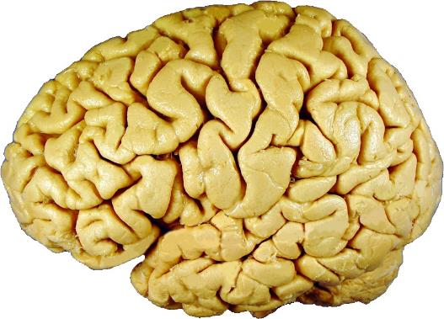
Lettered Sulci
Numbered Gyri
A – Lateral (Sylvian) Fissure
1 –
Precentral Gyrus
B – Central Sulcus
B
2 –
Postcentral Gyrus
C – Inferior Frontal Sulcus
3 –
Inferior Frontal Gyrus
4
4 –
Broca’s Area
1
2
Pars triangularis of Inferior Frontal Gyrus
5 –
Pars Opercularis of Inferior Frontal Gyrus
6 –
9
7 –
Pars Orbitalis of Inferior Frontal Gyrus
8
D
5
6
3
7
C
10
8 –
Middle Frontal Gyrus
11
9 –
Superior Frontal Gyrus
D – Superior Frontal Sulcus
E
10 –
Superior Temporal Gyrus
A
11 –
Middle Temporal Gyrus
E – Superior Temporal Sulcus

Slide 4
Lettered Sulci
A – Lateral (Sylvian) Fissure
B – Central Sulcus
B
C – Inferior Frontal Sulcus
4
1
2
9
8
D
5
6
3
7
C
10
11
D – Superior Frontal Sulcus
E
A
E – Superior Temporal Sulcus

Slide 5
Lettered Sulci
Numbered Gyri
A – Lateral (Sylvian) Fissure
1 –
Precentral Gyrus
B – Central Sulcus
B
2 –
Postcentral Gyrus
C – Inferior Frontal Sulcus
3 –
Inferior Frontal Gyrus
4
4 –
Broca’s Area
1
2
Pars triangularis of Inferior Frontal Gyrus
5 –
Pars Opercularis of Inferior Frontal Gyrus
6 –
9
7 –
Pars Orbitalis of Inferior Frontal Gyrus
8
D
5
6
3
7
C
10
8 –
Middle Frontal Gyrus
11
9 –
Superior Frontal Gyrus
D – Superior Frontal Sulcus
E
10 –
Superior Temporal Gyrus
A
11 –
Middle Temporal Gyrus
E – Superior Temporal Sulcus

Slide 6
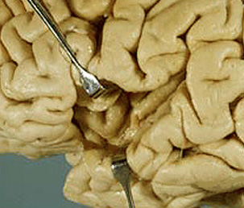
2 – Superior Transverse Temporal Gyri of Heschl
3 – Primary Auditory Cortex
2 – gyri?
3 – functional area?
1 – Lobe?
1 – Insular lobe

