Slide 1
Electrophysiology in a Rodent Epilepsy Model
Kimberle M. Jacobs, PhD
Associate Professor
Anatomy & Neurobiology, VCU
www.kmjacobslab.org
Video 1
Tonic clonic.mp4
Video 2
Absence seizure2.mpg
https://vcu.mediaspace.kaltura.com/media/Phys691_Vid2+Absence+Seizure2/1_zrziz45b
https://vcu.mediaspace.kaltura.com/media/Phis691_Vid1+tonic+clonic/1_bb7iyp46

Slide 2
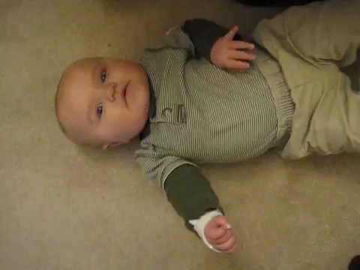
Seizures Types
Focal Seizure
Focal onset seizure:
https://vcu.mediaspace.kaltura.com/media/Phys691_vid3+Focal+simple-partial-motor-seizure-54z/1_i9wuyi71
Psychogenic seizure
Conversion Disorder PNES . . .mp4
https://vcu.mediaspace.kaltura.com/media/Phys691_vid4+psychogenic+seizure++Conversion+Disorder+PNES+PTSD+Somatization+Disorder/1_2zmddi4n

Slide 3
Epilepsy: Clinical Basics
Epilepsy is a syndrome because the same behavioral (and neural) symptoms arise from different disease causes
It is defined by recurrent seizures, caused by sudden synchronous electrical activity in the brain
Identified specifically on EEG because there are pseudo-seizures
Incidence is 1-3% worldwide with higher incidence in developing countries, the most common neurological disease, 65 million people worldwide. Incidence of seizure is 10% lifetime risk. (World Health Organization)
It is a costly disease because it is chronic and for many patients that have seizures controlled by medications, at different times in their lives, stress, aging, or for other spontaneous and unknown reasons, the medications may cease being effective. It takes weeks to determine if a new medication will reduce seizures. Some patients are on 4 or more drugs.
~1/3 of patients are not well controlled by medications or other treatments (surgery, diet, stimulators)
Epileptogenesis – more commonly studied, is the sequence of events that converts a normal neuronal network into a hyperexcitable network, with an increased propensity for seizure or seizure-like activity.

Slide 4
Epilepsy co-morbidities: tag-along disease
Epilepsy risk in special populations:
The basic, underlying risk of developing epilepsy is about one percent. Individuals in certain populations are at higher risk. For example, it is estimated that epilepsy can be expected to develop in:
25.8 percent of children with mental retardation
13 percent of children with cerebral palsy
50 percent of children with both disabilities
10 percent of Alzheimer patients
22 percent of stroke patients
8.7 percent of children of mothers with epilepsy
2.4 percent of children of fathers with epilepsy
33 percent of people who have had a single, unprovoked seizure
7-25% of epilepsy patients have some form of psychosis, including schizophrenia

Slide 5
Presumed Predisposing Causes of Epilepsy
Idiopathic
CVD
Developmental
Others
Head Trauma
CNS
Brain Tumor
Many different causes means that epilepsy is actually a syndrome (collection of symptoms) rather than a single disease
Presumption that most of the idiopathic epilepsies are due to genetic mutations.
Idiopathic – cause unknown
CVD = Cerebrovascular Disease
Developmental = Structural Malformation
CNS = CNS infection like meningitis
Annegers, J.F. (1994) The Natural Course of Epilepsy: An Epidemiologic Perspective. In:
The Surgical Management of Epilepsy, Wyler, A.R. & Hermann, B.P. (eds.) Boston, Butterworth-Heinemann, pp. 3-7.

Slide 6
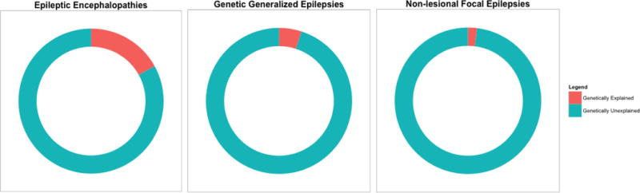
Genetics of Epilepsy
In the etiology of most epilepsies, a combination of acquired and genetic factors is involved, while predominantly genetic epilepsies constitute only a minority of all seizure disorders.
EpiPM Consortium 2015 A Roadmap for precision medicine in the epilepsies. The Lancet: Neurology, 14(12): 1219-1228.
Steinlein 2008 Genetics and epilepsy. Dialogues in Clinical Neuroscience, 10(1): 29-38.
Notes:
Oligogenic = determined by a small number of genes. Polygenic traits are considered non-Mendelian because their alleles are located on more than one gene which allows for more alleles and phenotypes. Examples of polygenic traits are hair color and height. Other traits, such as blood type, show codominance, where there is no dominant or recessive allele.
Before the development of next-generation sequencing, both linkage analyses and targeted candidate gene studies identified a number of epilepsy genes

Slide 7
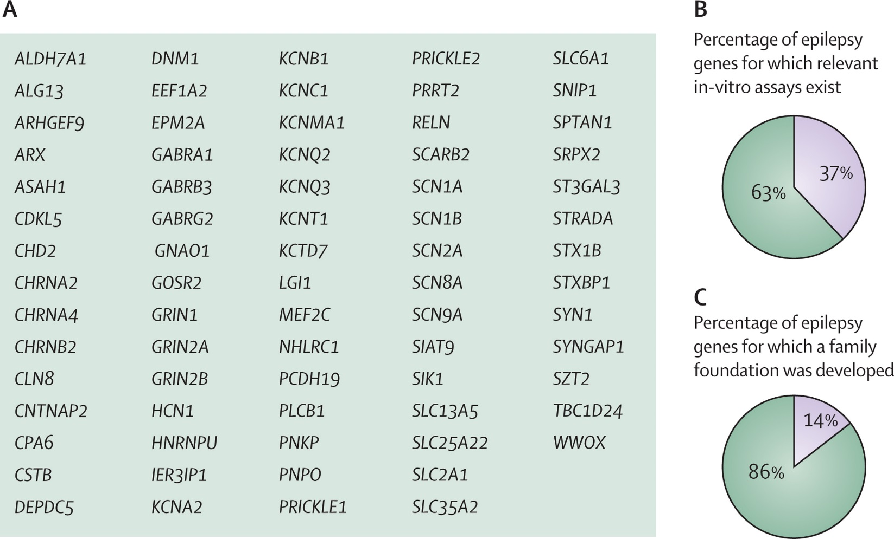
Genetics of Epilepsy
In the etiology of most epilepsies, a combination of acquired and genetic factors is involved, while predominantly genetic epilepsies constitute only a minority of all seizure disorders.
EpiPM Consortium 2015 A Roadmap for precision medicine in the epilepsies. The Lancet: Neurology, 14(12): 1219-1228.
Explore all 76 epilepsy genes: https://www.cureepilepsy.org/egi/genes.asp
Notes:
Oligogenic = determined by a small number of genes. Polygenic traits are considered non-Mendelian because their alleles are located on more than one gene which allows for more alleles and phenotypes. Examples of polygenic traits are hair color and height. Other traits, such as blood type, show codominance, where there is no dominant or recessive allele.
Before the development of next-generation sequencing, both linkage analyses and targeted candidate gene studies identified a number of epilepsy genes

Slide 8
Examples of rare instances of monogenic inheritance of epilepsy gene
Steinlein 2008 Genetics and epilepsy. Dialogues in Clinical Neuroscience, 10(1): 29-38.
CHRN – alpha4 or beta2 subunits of the neuronal nicotinic acetylcholine receptor – mutations target channel’s gating structure, typically resulting in increased sensitivity to agonist.
CHRNA4-776ins3 mutation – more than half of the 11 family members have schizophrenia or severe apathy.
Notes:
ADNFLE – autosomal dominant nocturnal frontal lobe epilepsy – have brief motor seizures mostly out of nonREM sleep
KCNQ – votage-gated potassium channels - more than 40 different types of mutations in these genes. – encodes M-current – a powerful controller of neuronal firing – regulates the AP frequency. Mutations cause 20-30% reduction in current.
SCN – voltage-gated sodium channel subunit gene –mutation effects vary – some loss of function, altered gating properties or gain of function.
GABRA1 = alpha1 subunit of GABA-A receptor
CACNB4 – voltage gated calcium channel auxillary subunit beta4
CLCN – voltage dependent chloride channels
The EFHC1 gene provides instructions for making a protein called EF-hand domain containing protein 1. The EFHC1 protein interacts with another protein that acts as a calcium channel, allowing positively charged calcium atoms (calcium ions) to cross the cell membrane.
The LGI1 gene provides instructions for making a protein called leucine-rich glioma inactivated 1 (Lgi1) or epitempin. Some studies have suggested that epitempin plays a role in the normal function of potassium channels in neurons.

Slide 9
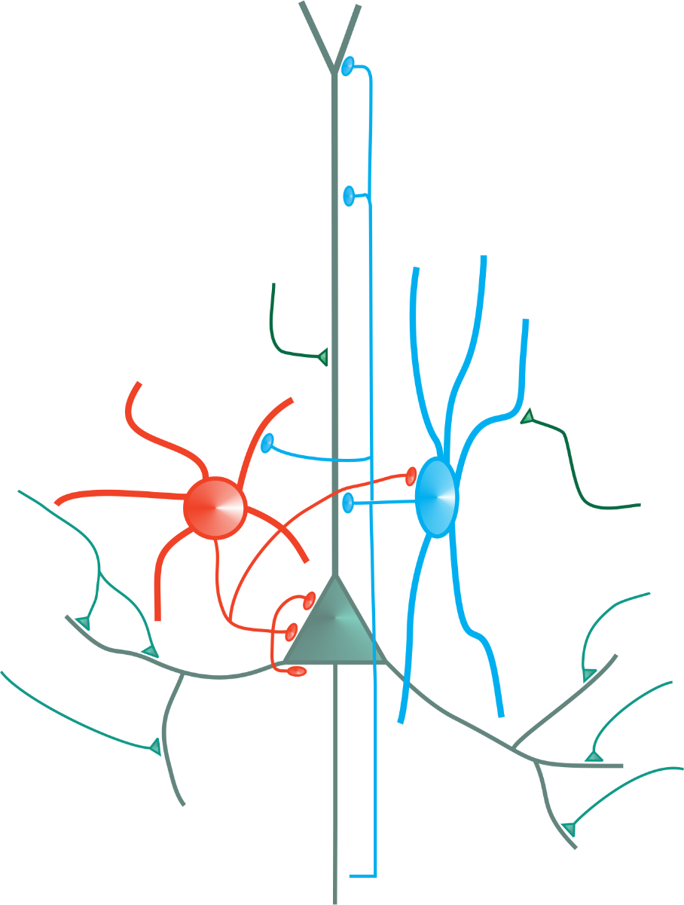
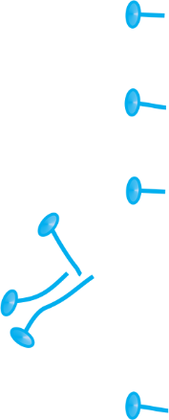


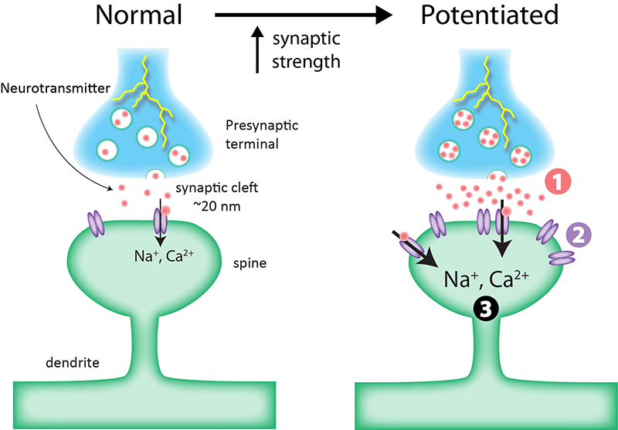

Likely ‘players’ in neurological abnormalities
Sprouting, pruning, or changing postsynaptic partner type
Intrinsic refers to channels embedded in that cells membrane
Intrinsic
Neuronal
Properties
Anatomical
(network)
Connectivity
Tested electrophysiologically and/or pharmacologically, can include the addition of new receptor types
Synaptic
Strengths &
Neurotransmitter
Receptors
https://qbi.uq.edu.au/brain-basics/brain/brain-physiology/long-term-synaptic-plasticity

Slide 10
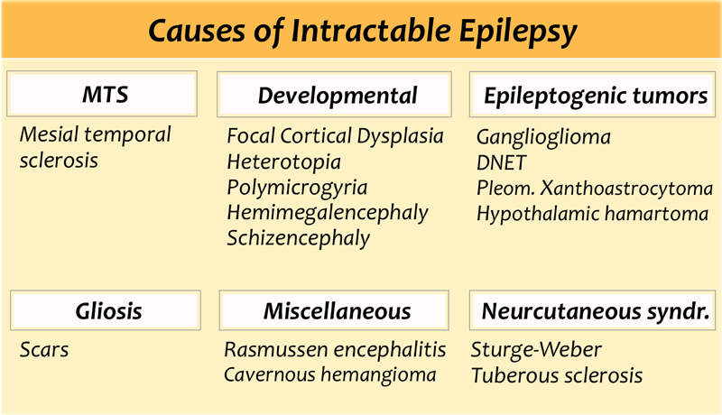
Some epilepsies recede with age or with time on AEDs.
So more importantly – what about the intractable epilepsies?
Notes:
What causes MTS? caused by oxygen starvation to the brain, head trauma, or brain infection, but can also occur without an apparent cause
DNET= Dysembryoplastic neuroepithelial tumour - slow growing glioneuronal tumours arising from either cortical or deep grey matter. The vast majority are centred in cortical grey matter, arise from secondary germinal layers, and are frequently associated with cortical dysplasia
Rasmussen's encephalitis, also known as chronic focal encephalitis (CFE), is a rare inflammatory neurological disease, characterized by frequent and severe seizures, loss of motor skills and speech, hemiparesis (weakness on one side of the body), encephalitis (inflammation of the brain), and dementia
Cavernous hemangioma, also called cavernous angioma, cavernoma, or cerebral cavernous malformation (CCM) (when referring to presence in the brain) is a type of blood vessel malformation or hemangioma, where a collection of dilated blood vessels form a benign tumor.
Sturge-Weber syndrome (SWS) is a neurological disorder marked by a distinctive port-wine stain on the forehead, scalp, or around the eye. This stain is a birthmark caused by an overabundance of capillaries near the surface of the skin. Blood vessels on the same side of the brain as the stain may also be affected - caused by a mutation in the GNAQ gene . The gene mutation is not inherited , but occurs by chance in cells of the developing embryo
Sturge-Weber syndrome is also accompanied by abnormal blood vessels on the brain surface and the loss of nerve cells and calcification of underlying tissue in the cerebral cortex of the brain on the same side of the brain as the birthmark. most infants will develop convulsive seizures during their first year of life. There is a greater likelihood of intellectual impairment when seizures start before the age of 2 and are resistant to treatment. Prognosis is worst in the minority of children who have both sides of the brain affected by the blood vessel abnormalities
Tuberous sclerosis complex is a genetic disorder characterized by the growth of numerous noncancerous (benign) tumors in many parts of the body. These tumors can occur in the skin, brain, kidneys, and other organs, in some cases leading to significant health problems. Tuberous sclerosis complex also causes developmental problems, and the signs and symptoms of the condition vary from person to person. Tuberous sclerosis complex often affects the brain, causing seizures, behavioral problems such as hyperactivity and aggression, and intellectual disability or learning problems

Slide 11
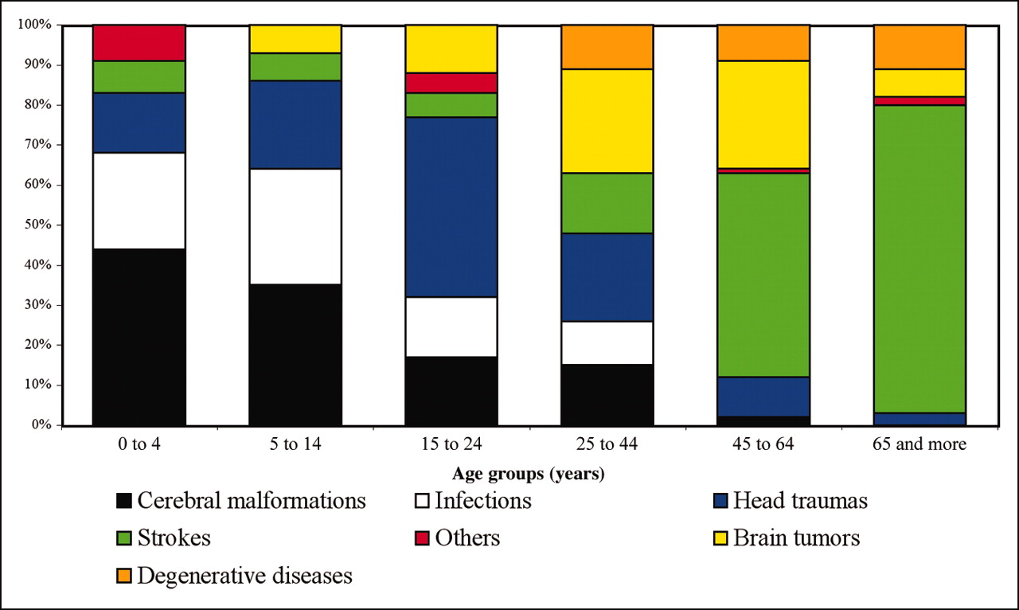
Epilepsy (known) causes vary with patient age
“Cortical dysplasia (CD) is the most frequent pathology found in pediatric epilepsy surgery patients with a nearly 80% incidence in children younger than 3 years of age.” Cepeda 2006 Epilepsy Behav, 9: 219.
% of patients
Dysplasia = the presence of cells of an abnormal type within a tissue, cortically can mean laminar disorganization, essentially here = a synonym for malformation.
At time of diagnosis
Major and Thiele 2007 Pediatrics in Review, 28(10): 363-371.

Slide 12
Need for novel treatments for patients with intractable seizures
CAUSES
RESULTS
Alcohol
Cocaine
Maternal Virus
Maternal Infection
Direct Trauma
Hypoxia
Genetic Mutation
Radiation
Dyslexia
Cerebral Palsy
Mental Retardation
Epilepsy
Down Syndrome
Schizophrenia ?
OCD ?
Autism ?
Structural
Developmental
Cortical
Malformation

Slide 13
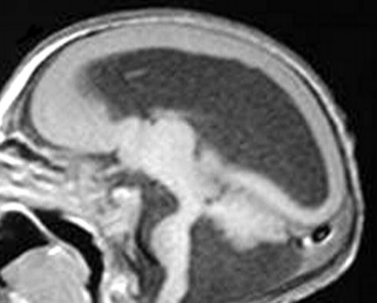
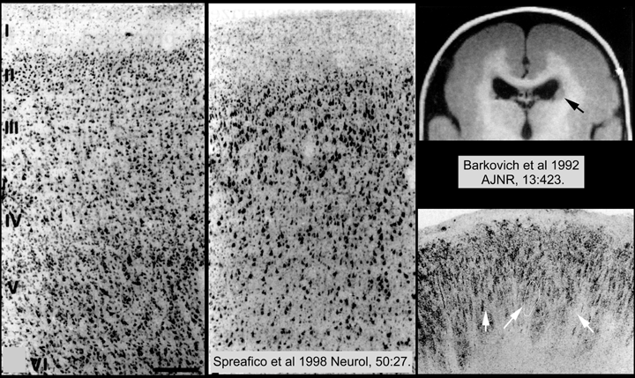
Types of structural malformations
Lissencephalies: smooth brain – loss of neurons, severe seizure, associated with mental retardation, poor prognosis.
Abdel Razek et al 2009 American Journal of Neuroradiology, 30: 4.
agyria
pachygyria
Most images from: Leventer 2005 Journal of Child Neurology, 20: 307.
Heterotopia – neurons located in the wrong place. Mild or moderate delay – wide range of abilities moderate to severe retardation in 41%. Cognitive level appears to correlate inversely with the thickness of the band (thicker band, less cognitive ability.
Subcortical Band Heterotopia
PVNH
Peri-ventricular Nodular Heterotopia
Notes:
Cognitive ability slows after seizure onset.

Slide 14
Genetics of Malformations
Parrini, Conti, Dobyns, Guerrini (2016) Molecular Syndromology, 7: 220-233.
Lissencephaly and SB heterotopias – 14 genes identified account for 90% of lissencephalies. Lis1 = gene for platelet-activating factor acetylhydrolase. Mouse (hetero) knockout produces disorganized cortex. DCX – microtubule-associated protein expressed in migrating neuroblasts. Affects microtubule stability. TUB = tubulin genes. FLNA – actin-binding phosphoprotein that stabilizes cytoskeleton. Migrating neurons may fail to attach to radial glia.
Notes:
Post-zygotic (somatic) de-novo mutations (panel) that are present in only a subset of cells have also been identified as the cause of malformation syndromes associated with severe epilepsy. Recent examples include somatic mutations in AKT3, MTOR, and PICK3CA as the cause of hemimegalencephaly and intractable seizures,^{53,} ^{54,} ⁵⁵ and somatic mutations in DCX, LIS1, FLNA, and TUBB2B as the cause of double cortex syndrome, periventricular nodular heterotopia, and pachygyria.⁵⁶ tubulin and tubulin motors can be affected: Microtubule motors such as dynein and kinesin move along microtubules through interaction with tubulin.

Slide 15
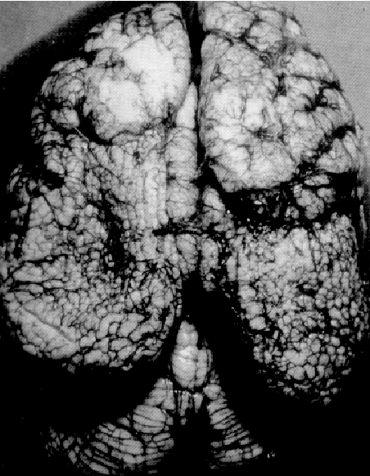
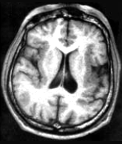
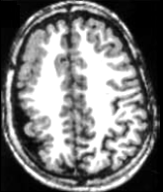
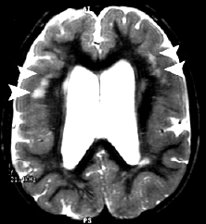
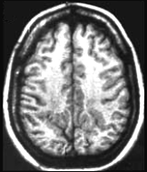
Polymicrogyria Forms
Bilateral Frontoparietal (BFPP)
PMG – both genetic and non-genetic causes. Non-genetic include fetal infection and fetal stroke.
Schizencephaly
BFPP: sometimes (<50%) associated with mutation in GPR56 gene
Piao et al (2005) Ann Neurol, 58: 680.
Barkovich et al (1992) Am J Neurorad, 13: 423.
Bilateral Perisylvian (BPP)
Bilateral Parietooccipital
Unilateral PMG
Guerrini (2005) Epilepsia, 46S1: 32.
Guerrini (2005) Epilepsia, 46S1: 32.
Blumcke et al (2009) Epileptic Disord, 11(3): 181-193,
Notes:
GPR56 is a member of the adhesion family of G protein-coupled receptors (GPCRs), - role in cell guidance and adhesion

Slide 16
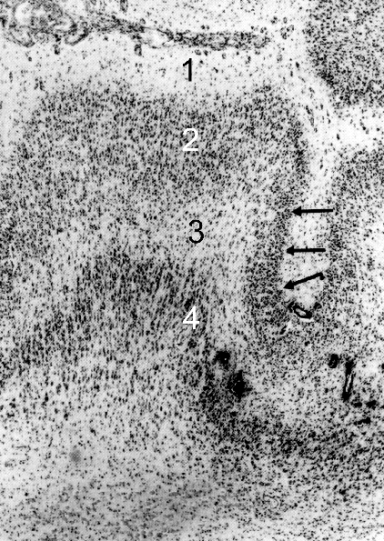
The Freeze Lesion Model of Microgyria
Neonatal transcranial freeze lesion in rodent or ferret
Some of the superficial layer cortical neurons have not yet migrated into the cortex
Lesion creates a focal loss of neurons in the cortical plate (deeper layer neurons) – mimics fetal stroke in likely causing loss of oxygen due to blood vessel coagulation
Lesioned area = microgyrus – has only 4 layers.
Surrounding microgyrus is paramicrogyral region or PMR – site from which epileptiform activity is most easily evoked
Human Microgyrus
Rat Microgyrus
I
II
1
III
IV
2
V
VI
3
4
VI_{b}
Human Microgyrus From: Robain, O. 1996 In: Dysplasias of Cerebral Cortex and Epilepsy.
P1 Lesion

Slide 17
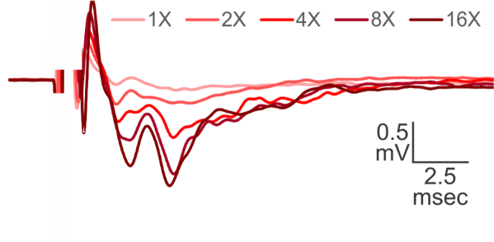
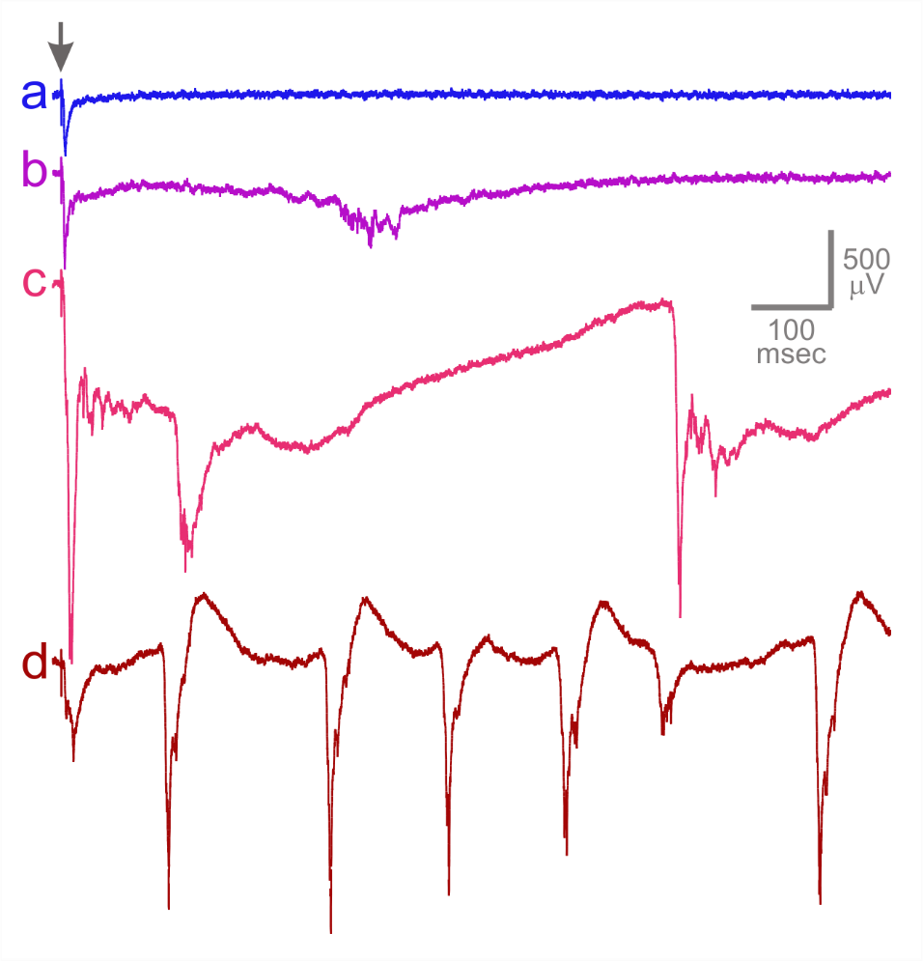
Recordings of Epileptiform Activity
Normal short latency response
Normal
Interictal
Ictal
Repetitive ictal
jeffreys AES talk
Right side of slide = Jacobs Lab recordings

Slide 18
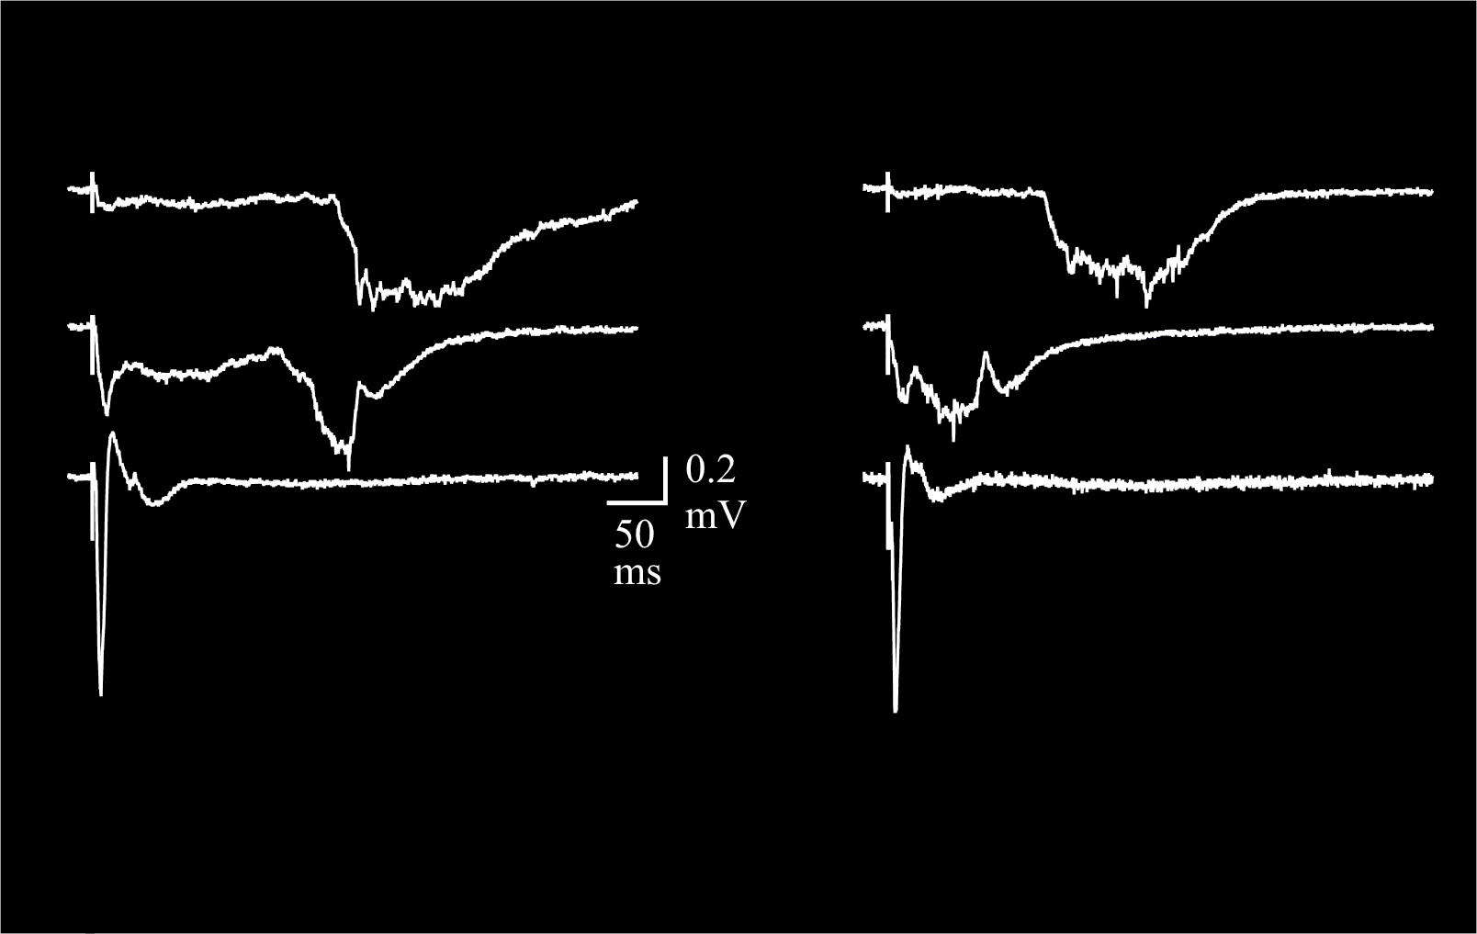
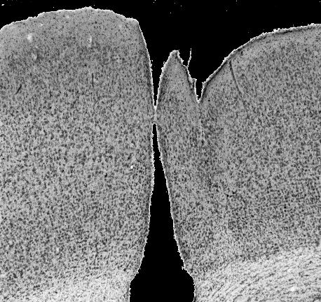
Paramicrogyral region (PMR) generates epileptiform activity
Sulcus
CUT
Before
sulcus
microsulcus
1
microgyrus
0.5 mm
Stim
sites
2
Field
Recording
Para-
microgyral
Zone
1.0 mm
3
2.0 mm
Stim
After
4
0.25
mV
20 ms
P0 lesions
P1 lesions
100
80
P9
P16
60
2X
% of rats with epi in >1 slice
40
20
**
16X
0
3
2
8
12
12
17
6
12
10
7
9 - 10
12 - 18
19 - 29
30 - 40
> 40
Survival Age (days)
Jacobs, Hwang & Prince 1999 J Neurophysiol., 81: 159.

Slide 19
The PMR contains an excess of excitatory input
Evidence for this result in Jacobs et al 1999 Cerebral Cortex, 9: 733-744.

Slide 20
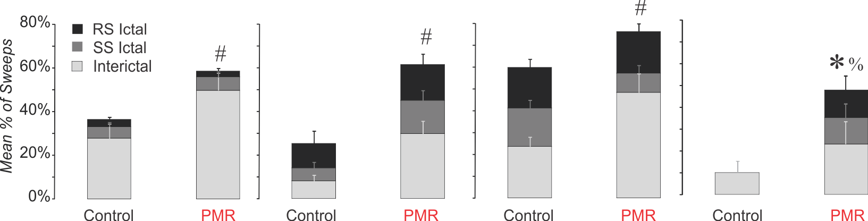
Increased excitatory input to the PMR
P7
P8
P9
P10
P11
Frequency of mEPSCs is correlated to # of synaptic inputs, assuming no change in release probability.
sEPSCs
mEPSCs
*
*
8
8
P0 lesions
P1 lesions
6
*
6
100
Frequency (Hz)
Frequency (Hz)
80
4
4
60
% of rats with epi in >1 slice
40
2
2
20
**
0
3
2
8
12
12
17
6
12
10
7
0
13
13
11
14
14
9
10
12
10
14
0
4
5
7
9
7
6
5
8
5
6
9 - 10
12 - 18
19 - 29
30 - 40
> 40
Control
PMR
Control
PMR
Survival Age (days)
Zsombok & Jacobs 2007 Journal of Neurophysiology, 98:178-186.
In low Mg2+ slice solution,
Epileptiform activity occurs
Bell and Jacobs 2014 Epilepsy Res, 108: 241-250.
P7 - 9
P10-11
P12-15
P28-36

Slide 21
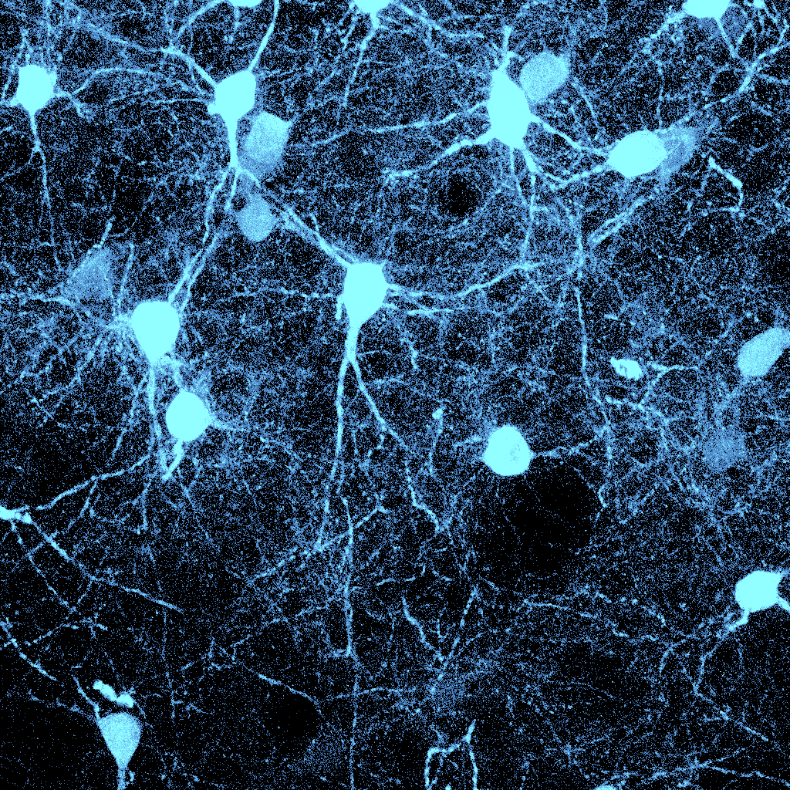
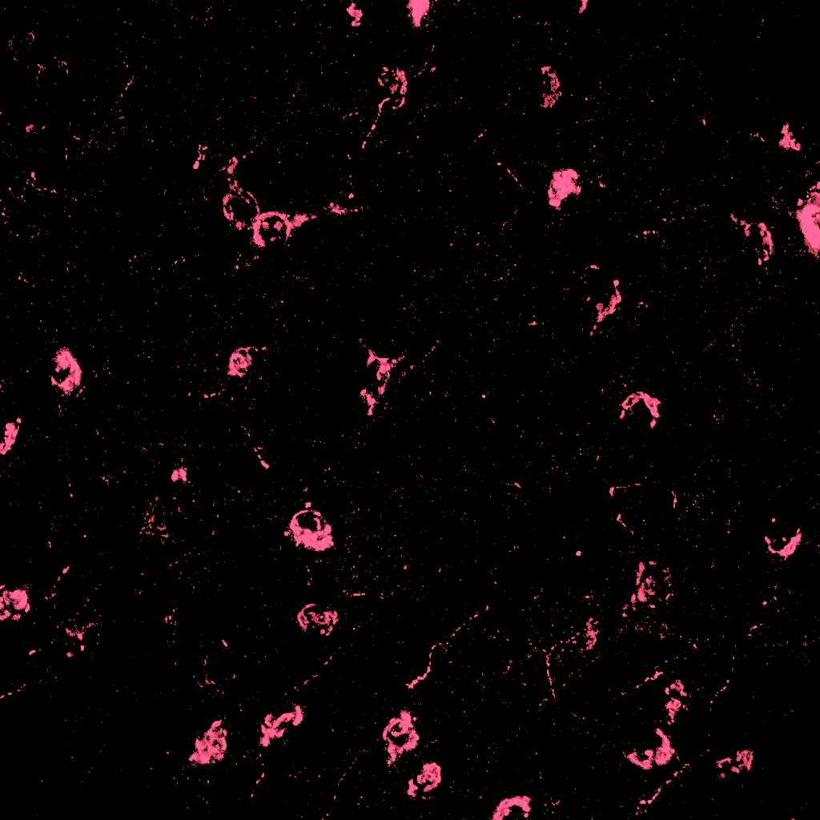
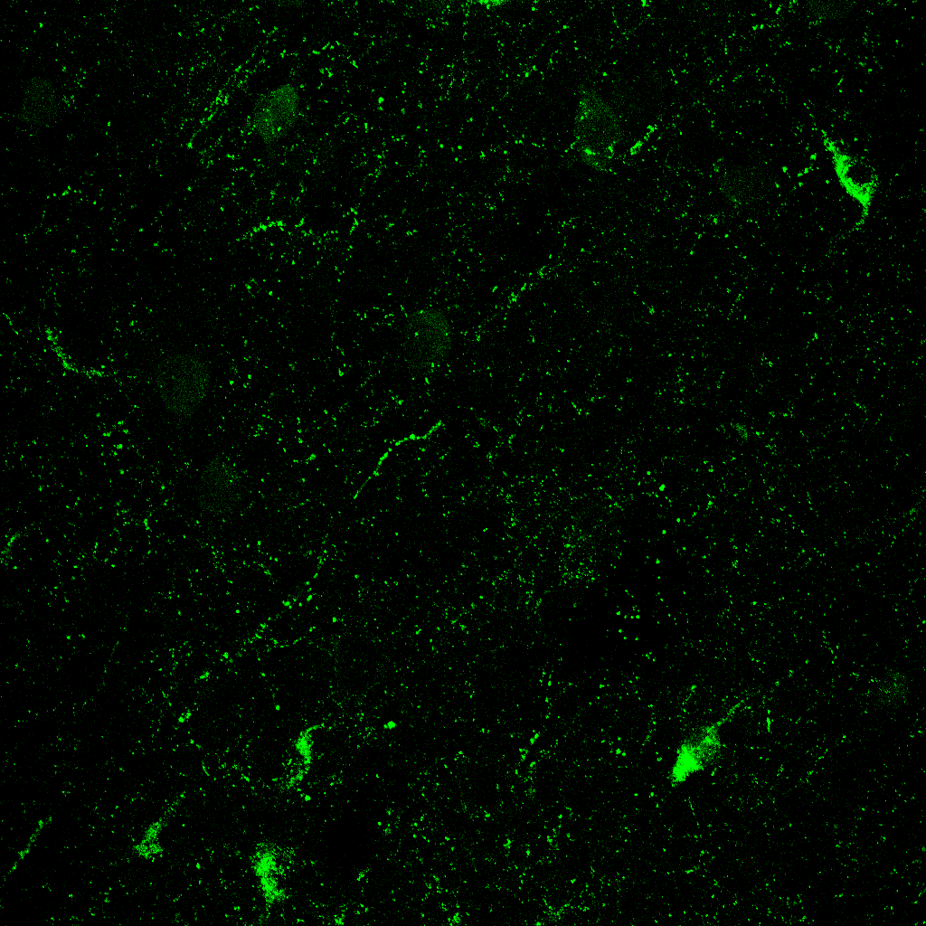
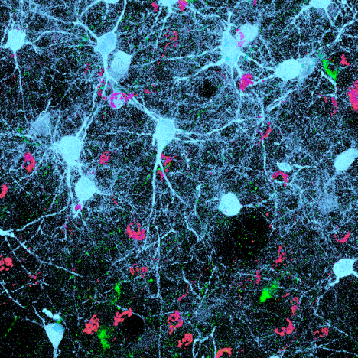
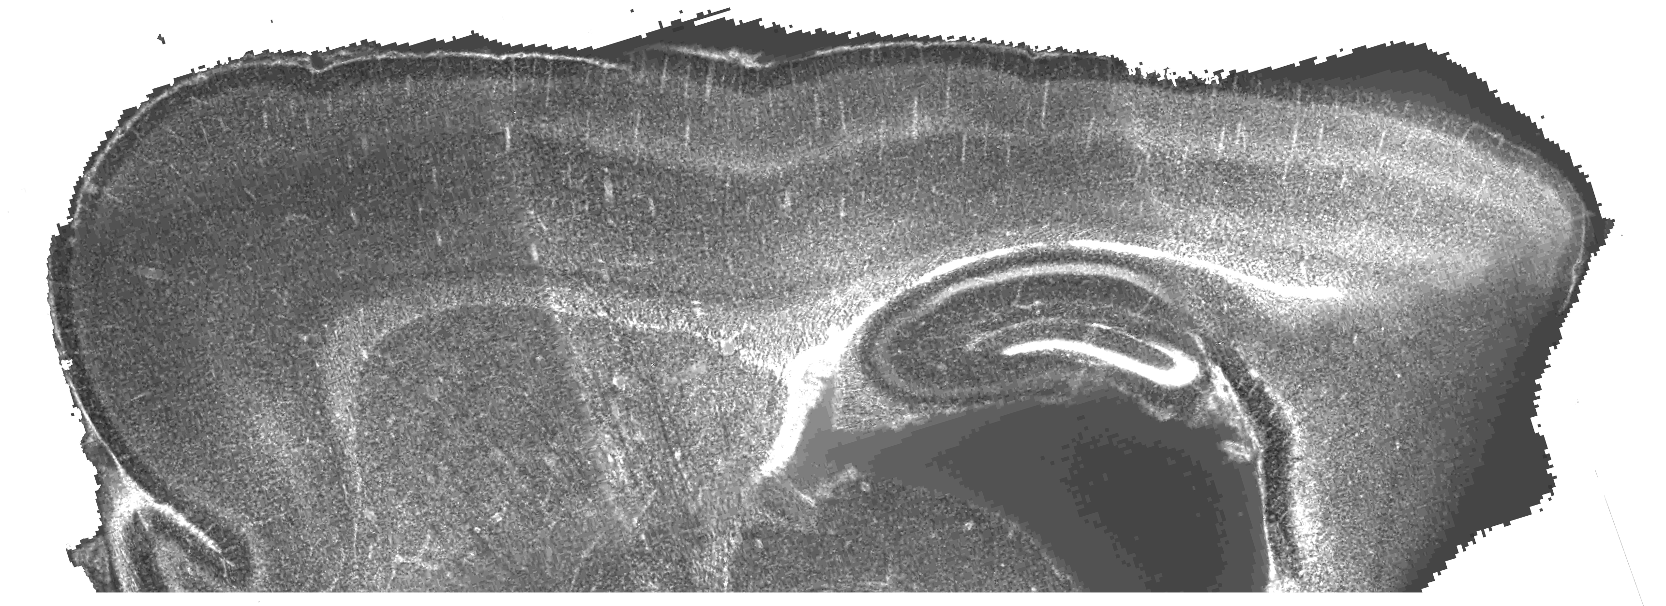
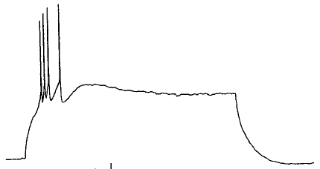
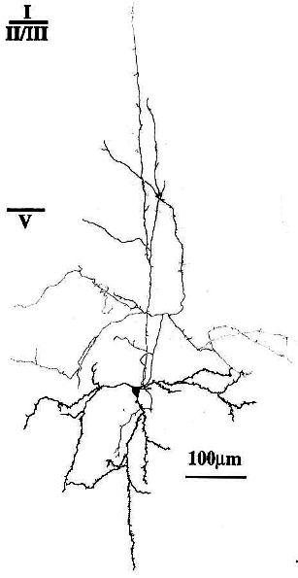
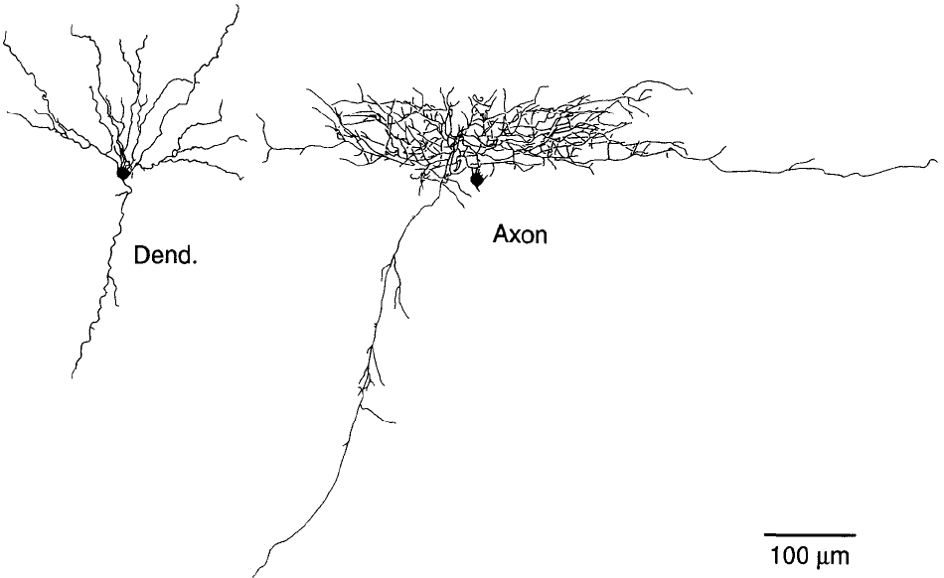
Isn’t all inhibition the same independent of cell type?
Somatostatin
VIP
Overlap
Bisbenzimide
Parvalbumin
16
Layer II/III
Layer IV
Layers V/VI
Control
PMG
3
3
12
Ratio of SS to PV
2
2
8
4
1
1
0
MG
PMR
2.2 mm
0
PMR
2.2 mm
0
PMR
2.2 mm
Fast-spiking, Parvalbumin-containing, with horizontally-projecting axons
FS
L
T
S
Low-threshold spiking, Somatostatin-containing, with vertically-projecting axons
Kawaguchi 1995 J Neurosci, 15: 2638.
Kawaguchi 1996 J Neurosci, 16: 2701.

Slide 22
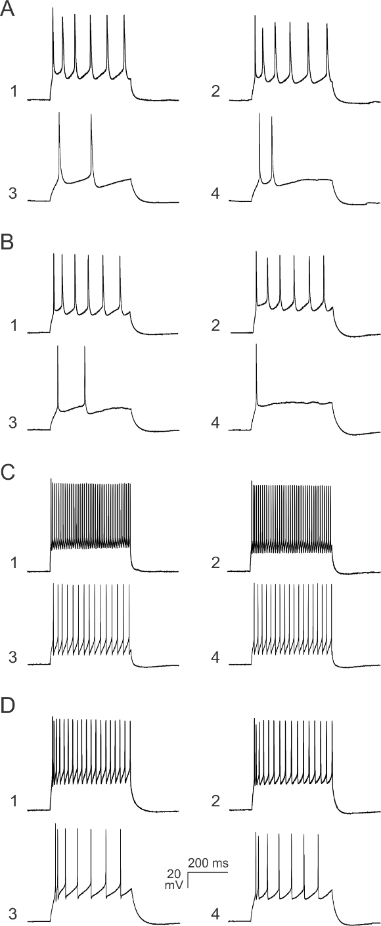
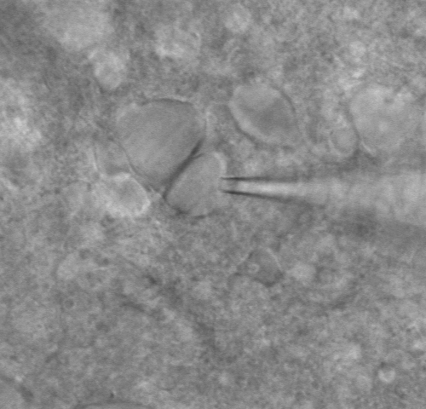
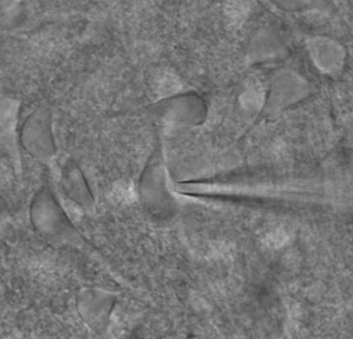
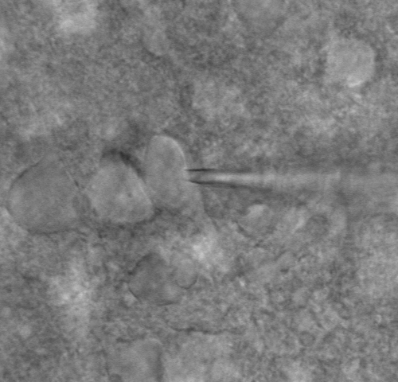
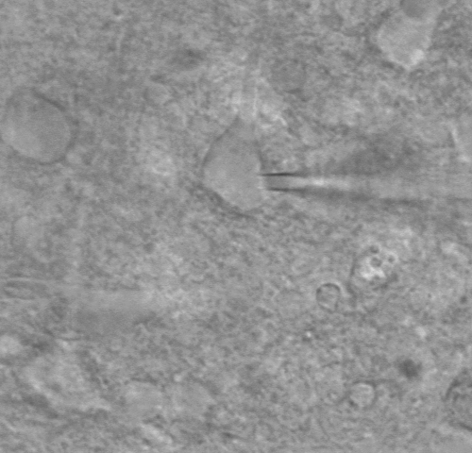
Differentiation of Neuronal Subtypes
Control
PMR
Pyr
Pyr
Non-Pyr
LTS
Pyr
FS
Sus Pyr
Unknown Type
Control Cells
PMR Cells
Sus
Pyr
15
15
10
10
5
5
0
0.0
0.2
0.4
0.6
0.8
1.0
First minus Last AHP peak (mV)
FS
First minus Last AHP peak (mV)
0
0.0
0.2
0.4
0.6
0.8
1.0
-
5
-
5
-
10
-
-
10
15
Adaptation (last/first AP interval)
-
Adaptation (last/first AP interval)
-
15
LTS
20
George & Jacobs 2011 Brain Res, 1374: 116-128.

Slide 23
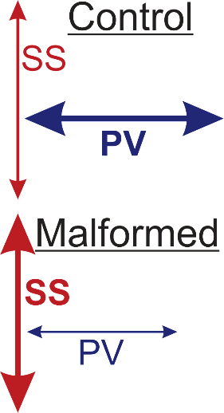
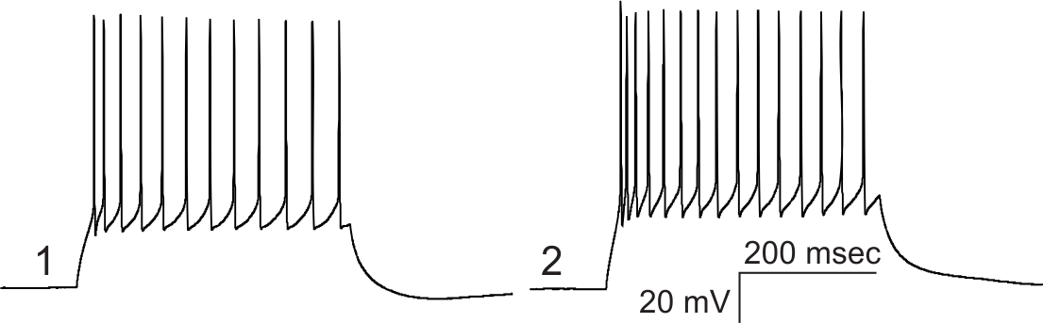
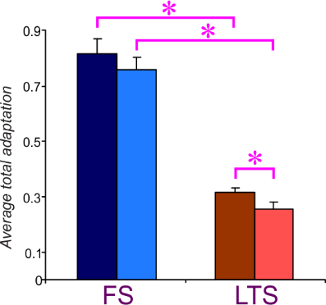
Intrinsic Property Alterations in the PMR
Control LTS
PMR LTS
Control FS
PMR FS
Maximum Firing Frequency
Total Adaptation
*
Control LTS
*
150
125
100
PMR LTS
Maximum Frequency (Hz)
75
50
FS
LTS
George & Jacobs 2011 Brain Res, 1374: 116-128.

Slide 24
Excitatory input to LTS interneurons is increased in the PMR
Control LTS
PMR LTS
Control FS
PMR FS
(14)
(9)
(17)
(12)
mEPSC Frequency
mEPSC Amplitude
10
35
8
*
30
25
6
Frequency (Hz)
20
Amplitude (pA)
4
15
10
2
5
L
T
S
0
LTS
FS
0
LTS
FS
LTS
Median
Mean
FS
)
2.0
)
2.0
c
c
e
e
20
s
s
F
m
1.5
F
m
1.5
r
FS
(
10
r
(
e
e
15
q
h
q
m
h
u
m
t
u
t
d
e
E
d
e
E
i
1.0
n
i
1.0
n
P
w
c
P
w
10
c
f
S
f
S
l
y
l
y
a
5
C
a
(
C
H
0.5
(
H
H
P
H
P
0.5
5
z
z
A
)
A
)
0.0
Control
PMR
0
0.0
Control
PMR
0

Slide 25
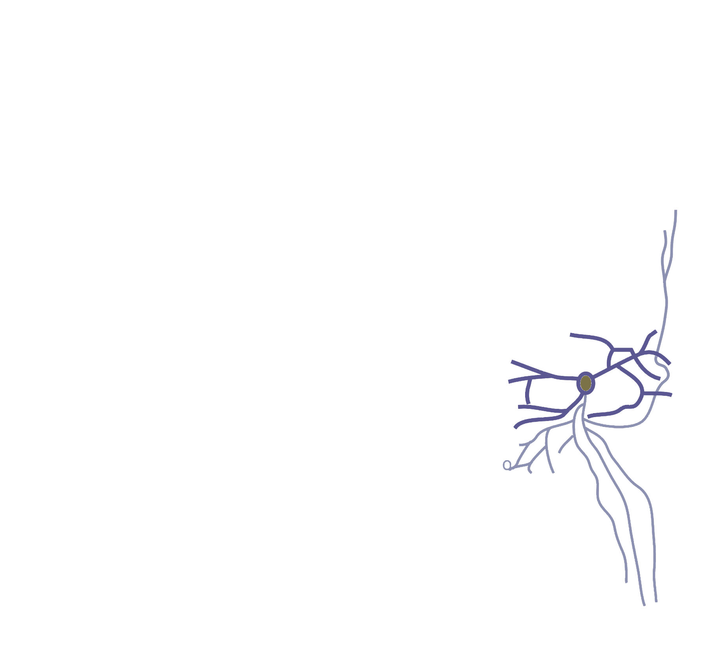
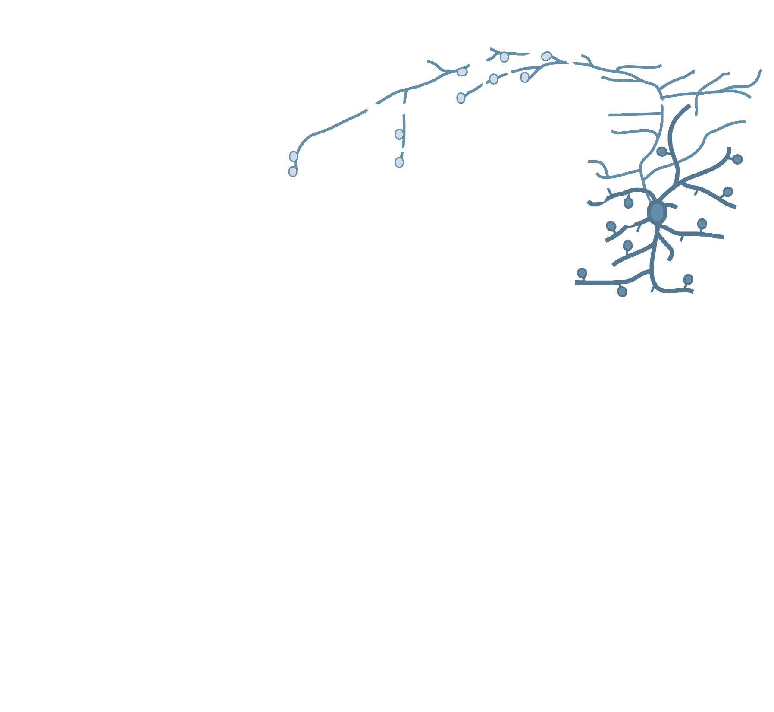

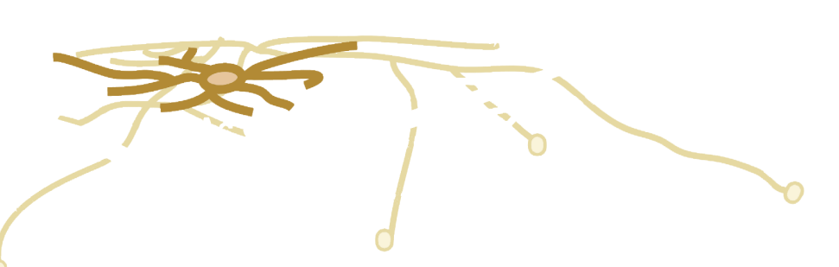
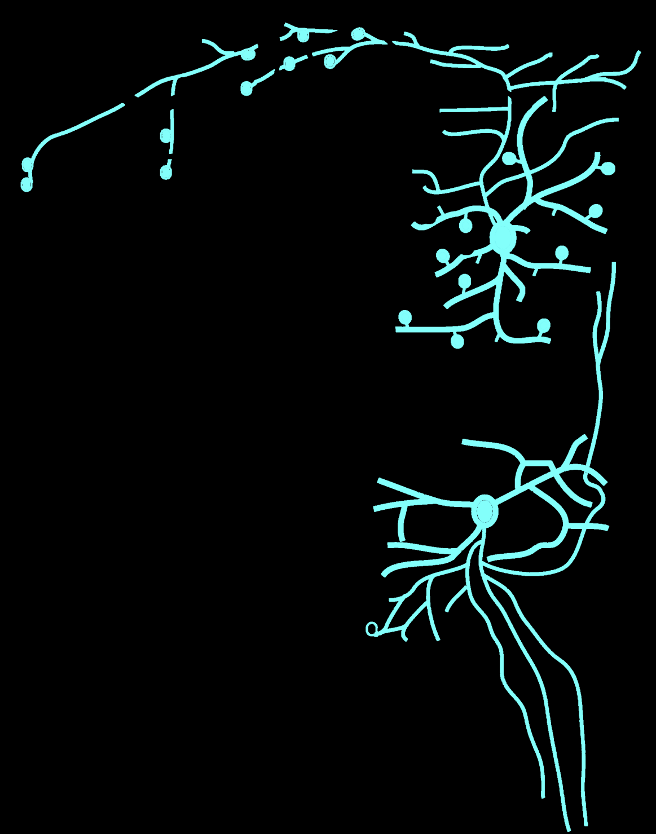
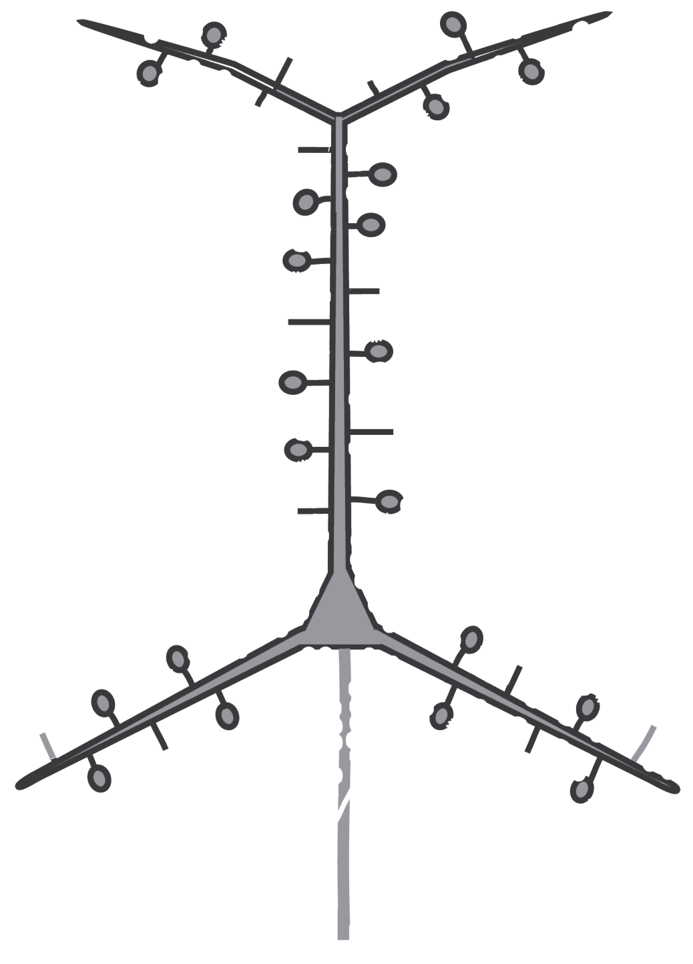

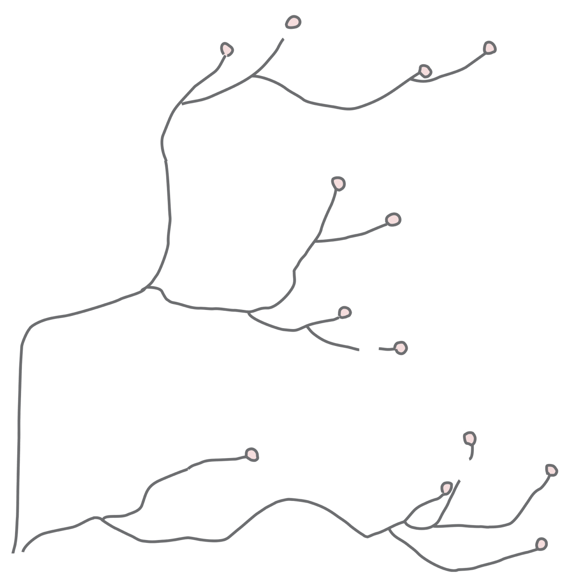
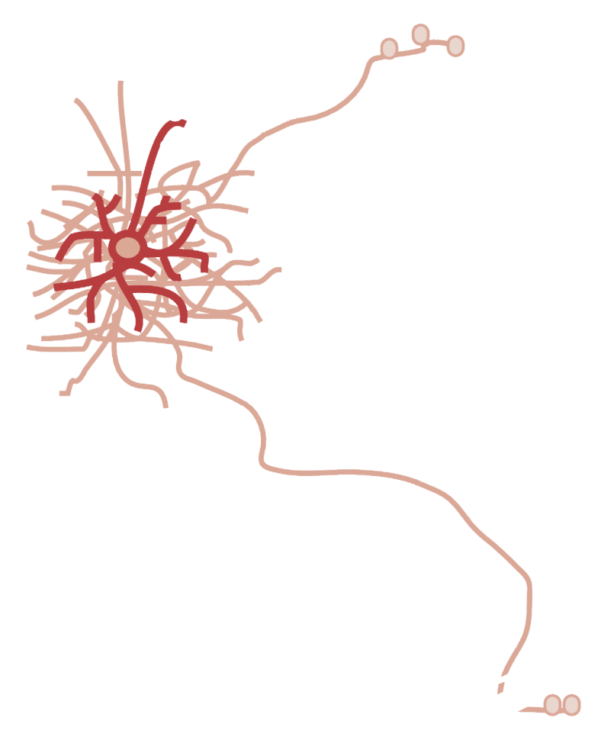
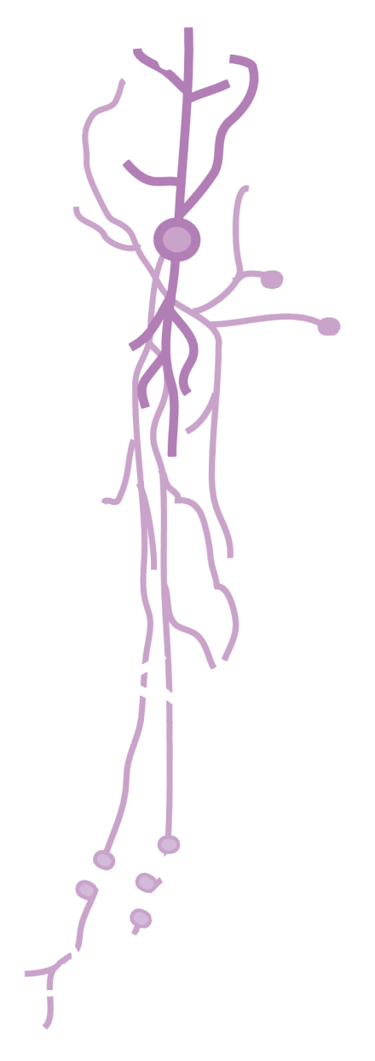
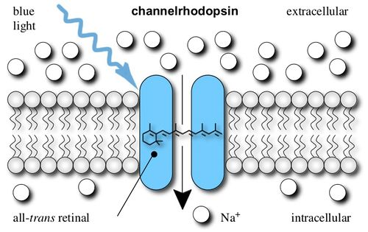
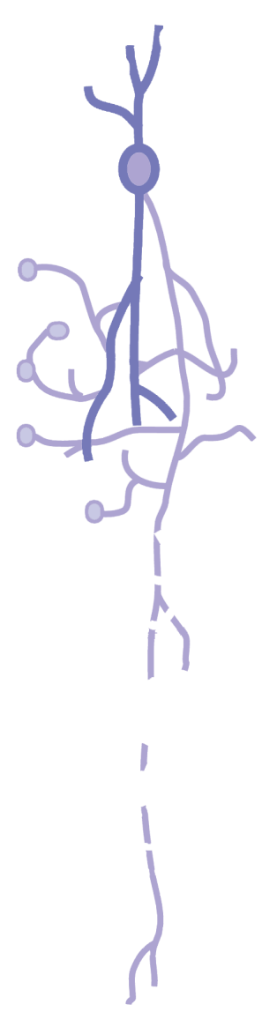
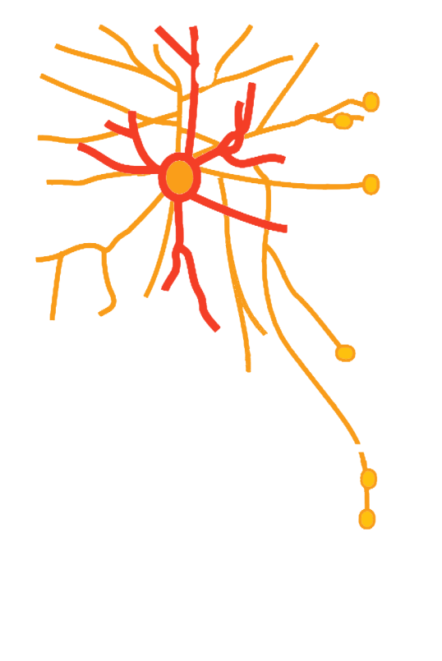

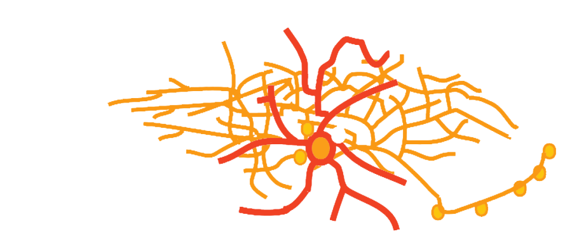
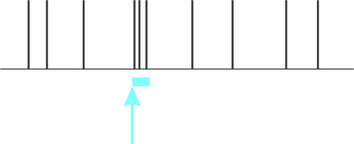




Single bouquet, CR
Neurogliaform
NPY
VIP
b-LED
Double
bouquet
CR
https://www.openoptogenetics.org/index.php?title=Channelrhodopsins
Non-Basket
Martinotti, NPY
SS
Small
basket
VIP
PV
FS
Basket
NPY, NOS
Thalamic
afferents
Chandelier
Figure modified from:
Kubota (2014) Current Opinion in Neurobiology, 26: 7.
modified from: https://www.jax.org/news-and-insights/jax-blog/2011/october/cre-lox-breeding-for-dummies-part-ii
Large basket, CCK

Slide 26





Recordings from layer V neurons
Blue light applied through 60X objective over the recorded layer V neuron

Slide 27


Do we get increased output from SS interneurons?
Blue light applied through 60X objective over the recorded layer V pyramidal neuron
Superficial layer light
Control
PMR
Increased output is selectively in layer V
Ekanem, Reed, Weston & Jacobs (2019) Epilepsia Open, 4: 334.

Slide 28

But can activation of SS interneurons initiate epileptiform activity?
Control
PMR
Control
PMR

Slide 29






Why would increasing SS inhibition produce network excitation?

Slide 30






How can we selectively activate the SS interneurons in vivo?
Through group I metabotropic glutamate receptors
(mGluR)
DHPG = Group I agonist
Selective Antagonists
mGluR1
- on Interneurons
- AIDA
Group I mGluR
mGluR5
- Primarily on Pyramidal neurons
- MPEP
Beierlein & Connors 2000 Nature Neuroscience, 3:904
Long et al 2005 Journal of Neuroscience, 25:7309.

Slide 31
We have some unpublished evidence that mGluR5 is increased in the PMR
That mGluR5 activates SS/LTS interneurons in the PMR but not in control
And finally that blocking mGluR early in development decreases the subsequent epileptiform activity

Slide 32
All categories of neural mechanisms are active in malformed cortex
SS maximum firing,
And increased frequencies during trains due to lowered AHP and less adaptation
Excitatory afferents, and inhibitory innervation of inhibitory cells
Intrinsic
Neuronal
Properties
Anatomical
(network)
Connectivity
Synaptic
Strengths &
Neurotransmitter
Receptors
New functional activity of mGluR5 on SS interneurons – this receptor depolarizes the SS interneurons further increasing their output.

Slide 33
Research Summary and Future Directions
SS inhibitory interneurons are overactive and receive enhanced excitatory input in malformed cortex
This hyperactivity of inhibitory interneurons may produce network epileptiform activity through one of the following mechanisms:
Network disinhibition (SS increasing their inhibition of FS/PV and other inhibitory subtypes)
Increased columnar synchrony
It may be possible to control SS interneurons though the mGluR5 receptor (how selectively – not yet know)
Increased mGluR5 soon after the lesion may be part of the cause of abnormal cortical organization, since it is known that mGluR5 is required for proper developmental coordination between thalamic and cortical neurons
Blocking mGluR5 early may prevent the abnormalities in connectivity that occur during the normal developmental period
Increased mGluR5 may produce hyper-activation of the mTOR pathway, similar to the mGluR5 hypothesis of autism/fragile X syndrome.
Also: mutations in PIK3R2 , a pivotal gene of the PI3K-AKT-mTOR pathway, may account for up to 15% of all patients with bilateral perisylvian polymicrogyria Mirzaa et al., 2015
Are epileptogenic mechanisms similar in genetically- and environmentally-induced microgyria??? --Not yet known.

